Slide 1

Becoming Frontier
  Becoming
  Frontier
  2025.09.17 | Nick Fratello
Notes:
What I’d like the share with you today is all about this notion of Becoming Frontier.
You’re going to hear this expression a lot. Some of you may have heard it already in the industry. Effectively, what it means is becoming AI first in everything you do.
Before we dive into the deck, I’d first like to ask a few questions:
What are your primary business objectives with AI?
What would ‘good’ or ‘great’ look like if AI were to help achieve or accelerate your business goals and objectives?
Have you already tried Copilot, experimented with citizen development, and/or building your own AI solutions?

Slide 2
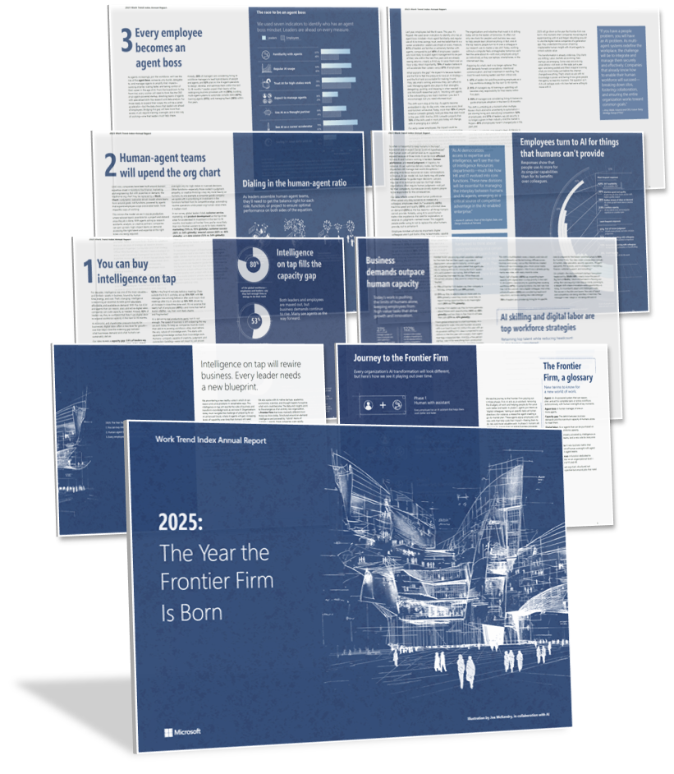




2025: The Year the Frontier Firm Is Born
2025 Work Trend Index Annual Report
31,000 people. 31 countries. Trillions of productivity signals.
AI is reshaping organizations into Frontier Firms
Human-agent collaboration is redefining roles
AI literacy and skilling are now critical workforce strategies
AI is driving a shift in organizational design
https://aka.ms/wti
Notes:
AI is reshaping organizations into Frontier Firms—companies powered by human-agent teams, intelligence on tap, and dynamic, outcome-driven structures that scale rapidly and operate with agility.
Human-agent collaboration is redefining roles—with agents automating workflows and employees evolving into “agent bosses” who delegate, manage, and optimize digital labor to amplify impact.
AI literacy and skilling are now critical workforce strategies—as companies prioritize upskilling, agent management, and hiring for AI-specific roles to stay competitive in a rapidly transforming labor market.
AI is driving a shift in organizational design—from rigid hierarchies to fluid, team-based structures where decision-making and innovation are accelerated by real-time data and intelligent systems.

Slide 3




Becoming Frontier
Success framework
Enrich
employee
experiences
Reinvent
customer
engagement
Reshape
business
processes
Bend the
curve on
innovation
Notes:
And at Microsoft, we’ve pulled together a framework for success on how to enable AI transformation across these four pillars you see on the screen.
What really matters the most is how you empower people, how you enable them to break through in the things that matter most for their business and enrichment to the employee experience.
Can they hire the best people in the industry to come work for their company? Are they delivering world-class tools for those people to use?
Can you help them break through with their customers, drive pipeline revenue growth, become more efficient at customer acquisition, and deliver more personalized solution?
Can you help them reshape their business processes? Can you help them bend the curve on innovation?

Slide 4
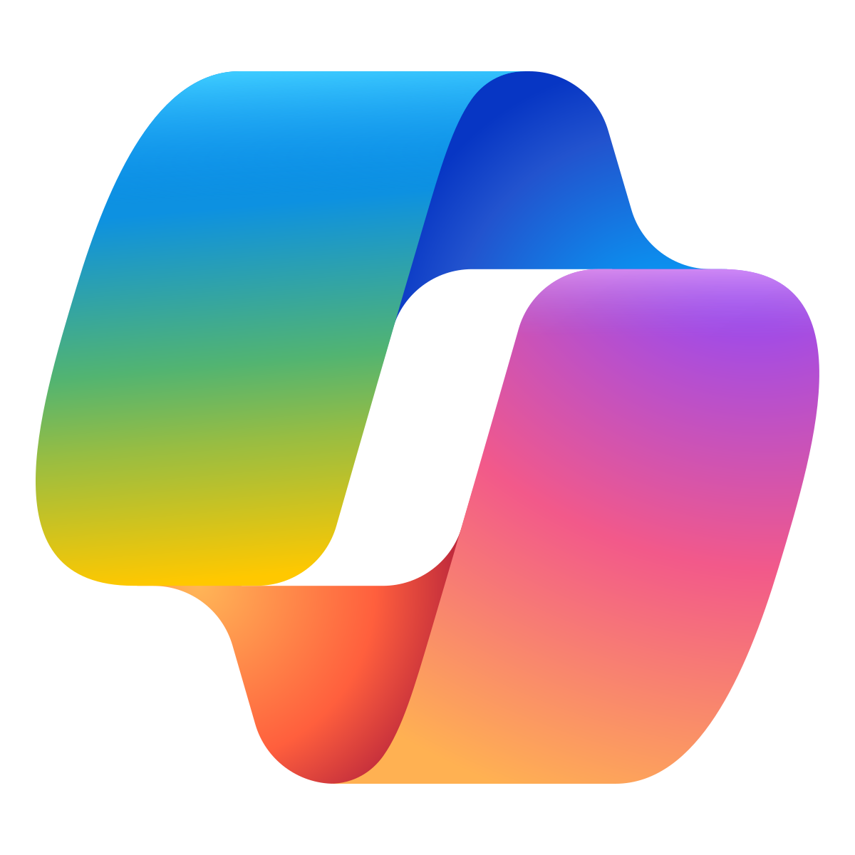
AI First Differentiation
Agents
Copilot
Human ambition
+
+
Notes:
One of the things we talk a lot about in this notion of becoming frontier is this formula for AI first differentiation: Agents + Copilot + human ambition making the difference.
Imagine a scenario where you want to research a topic as well as analyze a set of documents and then be able to synthesize all of that into a presentation for your leadership team.
Now, what if you were able to have agents working on your behalf for the first portion of that task, and then have Copilot serving as your personal assistant take the output of those agents and pull it all together?
That’s just an example of putting AI first – and when you combine these two things in agents and Copilot with human ambition, your organization can really flourish.

Slide 5
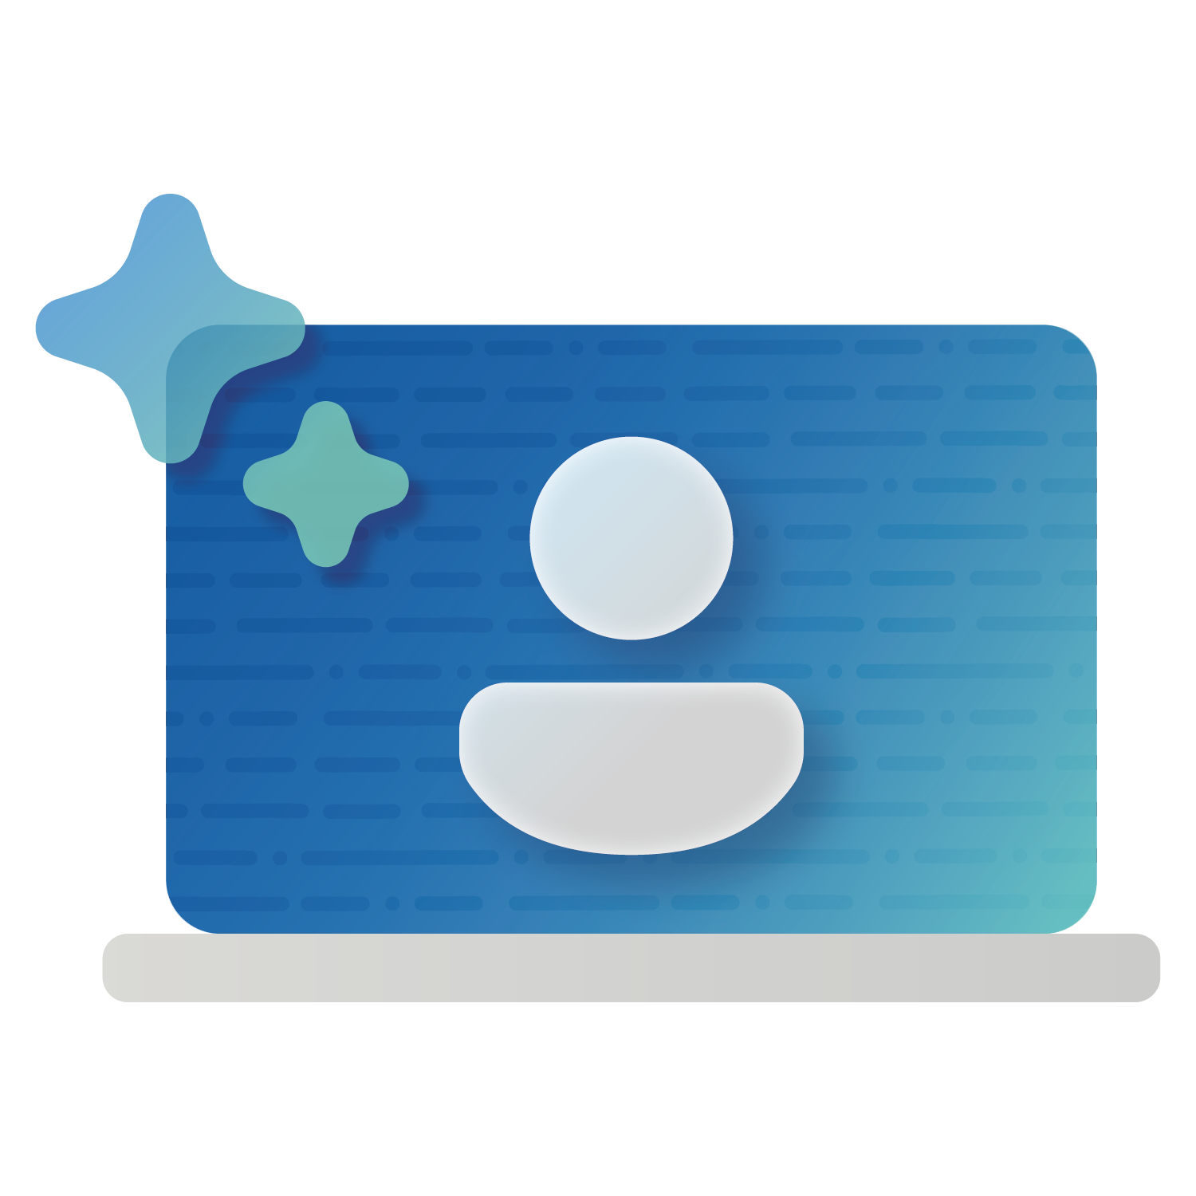
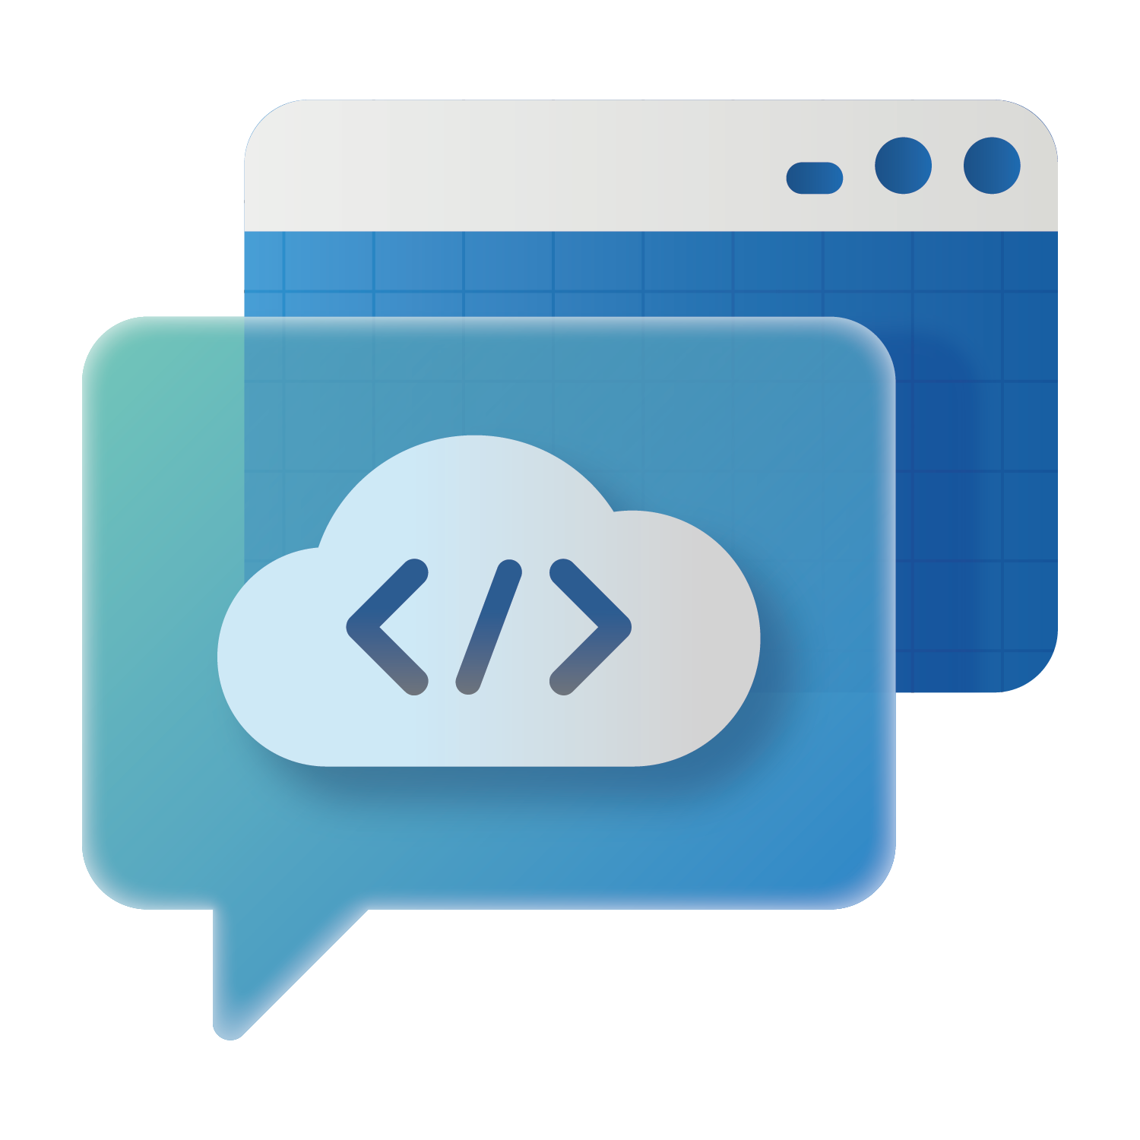

Becoming Frontier
Success framework
Approach
AI Business Solutions
Enrich employee experiences
Reinvent customer engagement
Cloud & AI Platforms
Reshape business processes
Security
Bend the curve on innovation
Notes:
This is the mission for us to drive AI-first differentiation in every pillar of engagement with every organization and customer across every industry around the world.
These four pillars of AI transformation and the framework for success, for becoming frontier, empowered by Microsoft’s solutions across:
AI Business Solutions – powerful tools, such as Copilot and agents, that can be integrated with your human capital to push the limits of productivity.
Cloud and AI Platforms – that are scalable and flexible, allowing you to pick and choose what best fit your business needs, allowing you to perform the necessary groundwork – with content safety and observability – to ensure your AI apps are yielding the desired results. And..
Security – solutions that empower you to build a zero-trust environment with appropriate endpoint protection, identity management, and incident response capabilities, so that you can ensure that your AI initiatives are secure.
So, let’s see how all of this comes to life through a company called Zava.

Slide 6

  Becoming
  Frontier
Notes:
This is the mission for us to drive AI-first differentiation in every pillar of engagement with every organization and customer across every industry around the world.
These four pillars of AI transformation and the framework for success, for becoming frontier, empowered by Microsoft’s solutions across:
AI Business Solutions – powerful tools, such as Copilot and agents, that can be integrated with your human capital to push the limits of productivity.
Cloud and AI Platforms – that are scalable and flexible, allowing you to pick and choose what best fit your business needs, allowing you to perform the necessary groundwork – with content safety and observability – to ensure your AI apps are yielding the desired results. And..
Security – solutions that empower you to build a zero-trust environment with appropriate endpoint protection, identity management, and incident response capabilities, so that you can ensure that your AI initiatives are secure.
So, let’s see how all of this comes to life through a company called Zava.

Slide 7
Enrich
employee
experiences
Notes:
Let’s start with enriching employee experiences:
Generative AI is a transformative technology that offers significant potential for enhancing employee productivity and wellbeing.
It can automate routine tasks, allowing employees to focus on more complex and creative work. This shift can lead to a more stimulating work environment and higher job satisfaction.
It can provide tools that can generate new ideas, products, and services, generative AI can spark innovation within organizations. Employees can leverage AI to explore new possibilities and drive growth.
AI can analyze vast amounts of data to provide insights that inform better decision-making. This can lead to more strategic and effective business outcomes.
It can even support employee learning by offering personalized training and development opportunities.
And ultimately, by reducing the time spent on mundane tasks, generative AI can contribute to better work-life balance. Employees can enjoy a more flexible work schedule and reduced stress levels.
Let’s look at a few real-world customer examples…

Slide 8






Enrich employee experiences
Reduced SOP documentation time from 1 hour to 10 minutes
20% reduction in response times for customer support
Improved knowledge retention and accessibility
Saved $1.1 million annually on helpdesk support
Reduced help desk demand by 25%-40% with chatbot
SAP unlock request process saved employees 840 hours
Reduced mean time to detect and respond by 20%
Enhanced team efficiency and productivity
Strengthened team expertise, focus, and accuracy
Microsoft 365 Copilot
Microsoft Copilot Studio
Microsoft Security Copilot
PG&E
Customer Story: https://aka.ms/PowerPlatform/PGE
Video: https://aka.ms/PGEVideo
Notes:
PG&E:
Who they are: PG&E is one of the largest combined natural gas and electric energy companies in the United States
Business Challenge: They faced business challenges related to streamlining and automating low-value work to focus on high-value tasks.
Opportunity with AI: PG&E sought to leverage AI and Copilot to address these challenges and capitalize on business opportunities for automation and innovation. One of the first groups to benefit from Power Platform development was PG&E’s Technology Service Center. As with many other organizations, PG&Es helpdesk agents were often burdened with mundane and repetitive requests that led to increased wait times for workers and reduced overall productivity.
A powerful chatbot named “Peggy” (a wordplay on “PG&E”) changed all of that. Built using Microsoft Copilot Studio (formerly Power Virtual Agents), Peggy can directly answer employees’ questions or redirect them to a specific resource.
Microsoft Technologies used:
Microsoft Power Platform: Enabled business users to build their own solutions and automate processes
Power Apps and Power Automate: Over 2,000 Power Apps applications and 4,200 Power Automate cloud flows were created, driving more than 315 business solutions
Center of Excellence (CoE): A small team within the CoE enabled 1,300 advanced Digital Creators and trained over 3,000 citizen developers
Managed Environments: Monitored data protection, applied best practices, and created sandbox environments for testing
Microsoft Copilot Studio (formerly Power Virtual Agents): Used to build a chatbot named "Peggy" that optimized helpdesk support
Business Outcomes:
Optimized Workloads: The introduction of a powerful chatbot named "Peggy" has significantly optimized agent workloads, allowing them to focus on more complex issues that require human intervention
Labor Savings: The automation of repetitive requests and processes has resulted in sizeable labor savings and service level improvements
Improved Service Levels: With the help of "Peggy," agents have more time to address issues that matter, improving the overall service level for their customers
Automated Processes: The chatbot has automated the end-to-end SAP account unlock request process, saving the team 840 hours per year
Business Impact: PG&E has realized significant cost savings and efficiency gains, with Power Platform solutions saving the company almost $75 million annually and the chatbot "Peggy" saving over $1.1 million annually in helpdesk support.
-----------------------------------------------
Eaton
Who they are: Eaton is a global leader in intelligent power management solutions, headquartered in Cleveland, Ohio. The company provides energy-efficient products and services for electrical, aerospace, and mechanical power management, serving customers worldwide.
Business Challenge: Eaton needed to manage thousands of standard operating procedures (SOPs) and improve data access across teams. Eaton’s finance teams, in particular, frequently need accurate data for complex reporting and analysis, while customer support agents rely on quick, easy access to information.
Business Opportunity with AI: These issues prompted the company to find an AI-Powered solution to streamline operations, automate documentation, and support knowledge transfer.
Microsoft Technologies Used: Eaton adopted Microsoft 365 Copilot to automate the creation of 1,000 SOPs, streamline customer service operations, and improve data access.
Microsoft 365 Copilot: Eaton adopted Microsoft 365 Copilot to centralize knowledge, support those objectives, and advance its aims of reducing costs and preparing for an evolving workforce.
Microsoft 365 Copilot for Service: was introduced to improve customer support by using CRM data for faster response times and enhanced customer experience.
Microsoft 365 Copilot for Finance: followed, integrating Salesforce insights into existing tools like Teams and Outlook to streamline sales processes and strengthen customer relationships.
Business Outcomes:
Reduced SOP documentation time from 1 hour to 10 minutes: Eaton reduced the time required to document standard operating procedures (SOPs) from 1 hour per SOP to a 10-minute streamlined process with Microsoft Copilot. This significant improvement enabled the finance team to meet ambitious project deadlines and focus on strategic work, driving operational efficiency across finance operations.
20% reduction in response times for customer support: By implementing Microsoft Copilot for Service, Eaton achieved a 20% reduction in response times for customer support. This improvement, driven by faster data access and CRM insights, enhances customer experience and strengthens Eaton's support approach.
Improved knowledge retention and accessibility: Copilot helped Eaton centralize knowledge, ensuring critical expertise is retained as the company prepares for workforce transitions. By improving data accessibility across departments, Eaton empowers employees to effortlessly uncover and utilize information, supporting continuity and a data-driven culture.
Business Impact: Eaton has a positive sentiment toward their AI-powered solution, describing Copilot as a jump start that drives efficiency, improves accessibility, and delivers tangible benefits across operations. They look forward to exploring advancements that will have significant impact, including enhancing productivity, strengthening customer support, and retaining organizational knowledge for workforce transitions.
--------------------------------------------------------------------
LTIMindtree:
Who they are: LTIMindtree is a global technology consulting and digital solutions company that enables enterprises across industries to reimagine business models, accelerate innovation, and maximize growth through digital transformation solutions. A Larsen & Toubro Group company, LTIMindtree serves over 700 clients across 30 countries.
Business Challenge: LTIMindtree faced challenges with swift incident responses in the evolving cybersecurity landscape, which diverted time and effort from developing innovative . This impeded their ability to offer high visibility, timely action, and robust security measures, critical for delivering cutting-edge services.
Business Opportunity with AI: LTIMindtree envisioned that integrating AI and generative AI, specifically Microsoft Copilot for Security, could automate incident responses, enhance threat intelligence, and streamline workflows, thereby improving efficiency and reducing routine tasks. This integration aimed to boost team productivity and allow them to focus on critical tasks and strategic priorities.
Microsoft Technologies Used: LTIMindtree partnered with Microsoft to integrate Microsoft Copilot for Security into their applications, customizing it to work with Microsoft Intune, Defender XDR, Defender Threat Intelligence, and Sentinel . The solution automates incident response, integrates threat intelligence, and provides advanced threat analysis, enhancing cybersecurity operations.
Microsoft Copilot for Security: Provides AI-enabled automated incident response, integrated threat intelligence, and advanced threat analysis, enhancing cybersecurity operations
Microsoft Intune: Manages and secures endpoints, ensuring that devices are compliant and secure
Microsoft Defender XDR: Offers extended detection and response capabilities, integrating data from various sources to provide a comprehensive view of threats
Microsoft Defender Threat Intelligence: Enhances understanding of entities involved in incidents by leveraging threat intelligence data
Microsoft Sentinel: Provides advanced threat detection and response capabilities, integrating with other Microsoft security tools to offer a unified security operations center
Azure Logic Apps: Facilitates the integration of Microsoft Copilot for Security with Microsoft Sentinel, enabling cohesive and integrated responses to cyberattacks
Business Outcomes:
Reduced Mean Time to Detect and Respond: The mean time to detect and respond to incidents has been reduced by 20%, thanks to the availability of critical guidance and context to security teams. This improvement allows for quicker incident responses and better protection of the IT environment at the speed and scale of AI.
Enhanced Team Efficiency and Productivity: The integration of Microsoft Copilot for Security has significantly boosted team efficiency and productivity by assisting in advanced threat hunting, building hunting queries, and converting natural language queries into Kusto Query Language (KQL) queries.
Strengthened Team Expertise and Focus: With generative AI support for investigative processes, automation of repetitive tasks, and streamlining of workflows, the solution has strengthened the team's expertise and allowed them to focus on critical tasks and strategic priorities. This has created a more fulfilling work environment for employees.
Business Impact: LTIMindtree has a positive sentiment towards their new AI-powered solution, viewing Microsoft Security Copilot as a true AI partner in cyber defense that enhances incident response, threat intelligence, and advanced threat analysis. They look forward to further integrating Microsoft Copilot for Security with Microsoft Sentinel using Azure Logic Apps to create a more cohesive and integrated response to cyberattacks.

Slide 9






Transform business processes with agents
IT/HR support agent helps employees and reduces costs and workload.
Banking agent helps customers unblock debit cards, change account limits etc.
Fraud detection agent autonomously flags and helps investigate suspicious transactions.
Simple
Advanced
Booking agent helps customers find and buy the right products.
Internal agent brings together complex config services for their global dealer network.
Sales agents help sellers prioritize customer leads and craft personalized proposals.
microsoft.com/customers
Notes:
Frontier Firms will be comprised of hybrid human-agent teams. Agents use AI to automate and execute business processes.
Lets spend a minute on what agents are and the spectrum of agents we see being used by our customers to transform their business processes :
On one end, you have Paypal is using a support agent which answers common employee questions via chat
On the end of the spectrum, you have sales agents at Fujitsu who are prioritizing leads and drafting proposals
There will be all types of agents in your organization – from those handling simple knowledge base queries to leading complex multi-agent workflows

Slide 10

Notes:
Holland America is an interesting example
Holland America,
Cruise line
Been around150 Years
with ports across all 7 continents
Handful of months they build two versions of their customer bookings agent
HAL – Anna
They came to us looking for a way to increase revenues and provide an upleveled digital concierge experience

Slide 11









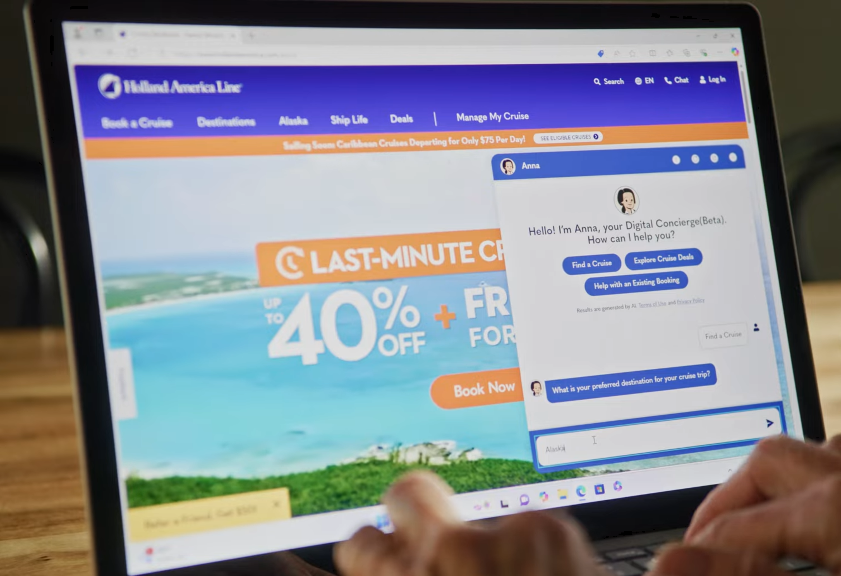


Microsoft
Copilot Studio
Anna
Hello! I’m Anna, your Digital Concierge.
How can help you?
Cruise Agent
Onboarding Assistant
FAQ Concierge
Travel Advisor
How can we help you today?
Scott Pettit, Sr Director E-commerce, Holland America
I am looking to book a cruise for my family of 4. Preferably 7 days and departing from Miami.
"With Microsoft Copilot Studio, we have an effective platform for delivering the benefits of generative AI to our customers, providing them with faster service and an even better overall cruise experience.” (Details)
Ask me a Question …

Slide 12
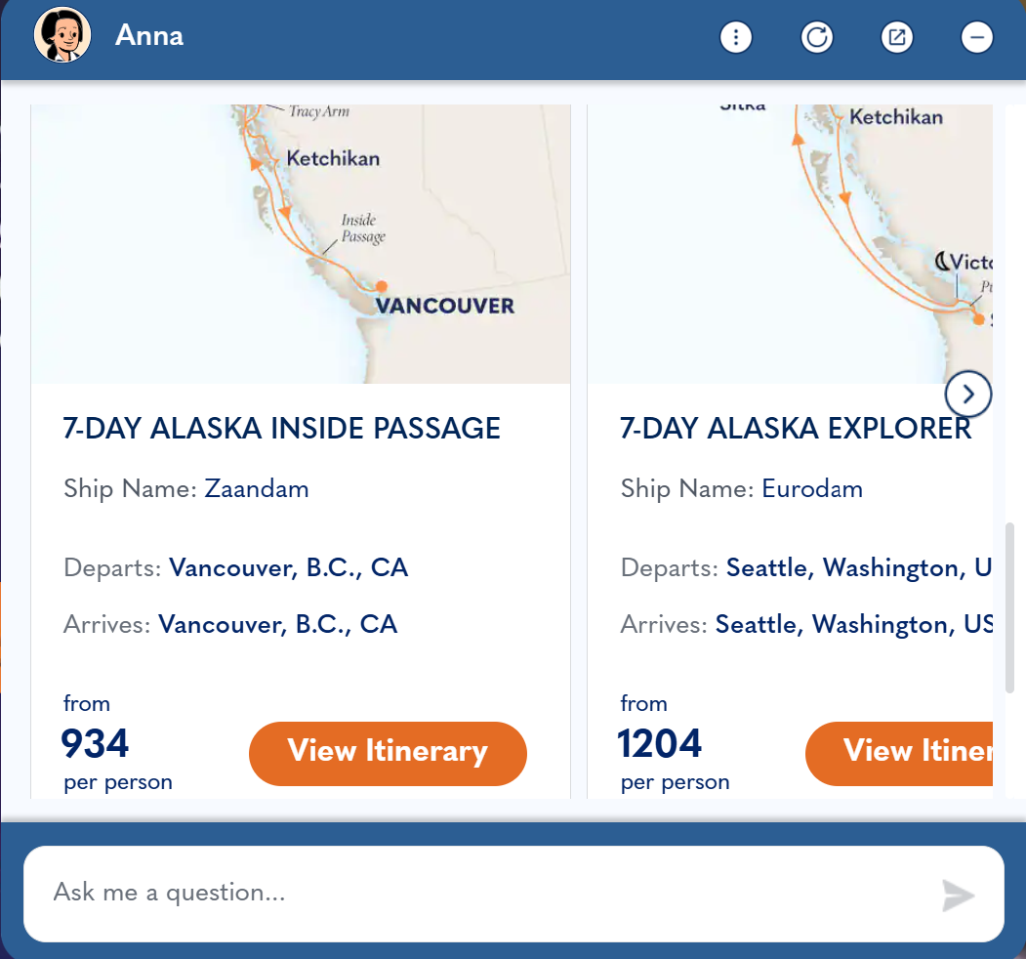
Microsoft
Copilot Studio
Anna
Hello! I’m Anna, your Digital Concierge.
How can help you?
Cruise Agent
Onboarding Assistant
FAQ Concierge
Travel Advisor
How can we help you today?
Scott Pettit, Sr Director E-commerce, Holland America
I am looking to book a cruise for my family of 4. Preferably 7 days and departing from Miami.
"With Microsoft Copilot Studio, we have an effective platform for delivering the benefits of generative AI to our customers, providing them with faster service and an even better overall cruise experience.” (Details)
Ask me a Question …

Slide 13


Holland America Line
Reinvent customer engagement
15,000+ conversations handled per week
Holland America Line implemented an AI agent named “Anna” using Copilot Studio to provide faster, personalized customer support. This integration has enhanced customer engagement and streamlined operations for the company.
$472K reduction in costs through call deflection
$308K savings per year on call center agent times
Online booking
$7M increase in annual revenue
$2.2M increase in incremental gross margin
Onboard and flights
$4M increase in annual revenue
$1.27M increase in incremental gross margin
Industry |  | Org size
Products
Travel/Transport
10,000+ employees
Copilot Studio, Azure
Read the full story here >

Slide 14

Copilot
Chat
Demo: Enrich employee experiences
M365
Copilot
Agents
Notes:
Let’s shift gears into the demo.
This demo shows how the Zava’s marketing team uses Copilot plus agents to explore new markets for fiber innovation, leading to a proposal for smart uniforms in pro sports—approved by leadership and moving into launch.

Slide 15
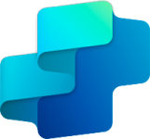
Microsoft Copilot Studio
Demo: Enrich employee experiences
Notes:
Moving onto the next demo.
This demo shows how the Zava marketing team uses Copilot Studio to create an agent that builds out a launch plan, identifies the inventory schedule, and writes out a go-to-market strategy for the new fiber for smart uniforms in pro sports, which was approved by leadership.

Slide 16

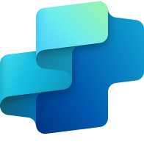


Becoming Frontier
Enrich
employee
experiences
M365 Copilot
Copilot Studio
Researcher agent
Analyst agent
Custom agents
Zava discovers competitive threat; adjusts launch strategy for ZavaCore
Zava’s GTM team builds the launch plan with the help
of agents
Notes:
You can see in a matter of minutes how an AI-first business process unlocks a tremendous amount of value.
Agents and Copilot coming together, unlocking human ambition to go and build this board-level presentation to create a product launch.
the combination of all of the richness of M365 Copilot, Copilot Chat, Copilot Studio, creating multiple agents working together in these AI-first business solutions to enrich the experience of all of the employees at Zava –
helping them research insights, break through, launch an awesome product to market to sell the sports leagues around the world and go public, creating an awesome experience for the Zava employees.

Slide 17
  Becoming
  Frontier
Demo

Slide 18
Becoming Frontier
Enrich
employee
experiences
M365 Copilot
Copilot Studio
Researcher agent
Analyst agent
Custom agents
Zava discovers competitive threat; adjusts launch strategy for ZavaCore
Zava’s GTM team builds the launch plan with the help
of agents
Notes:
You can see in a matter of minutes how an AI-first business process unlocks a tremendous amount of value.
Agents and Copilot coming together, unlocking human ambition to go and build this board-level presentation to create a product launch.
the combination of all of the richness of M365 Copilot, Copilot Chat, Copilot Studio, creating multiple agents working together in these AI-first business solutions to enrich the experience of all of the employees at Zava –
helping them research insights, break through, launch an awesome product to market to sell the sports leagues around the world and go public, creating an awesome experience for the Zava employees.

Slide 19
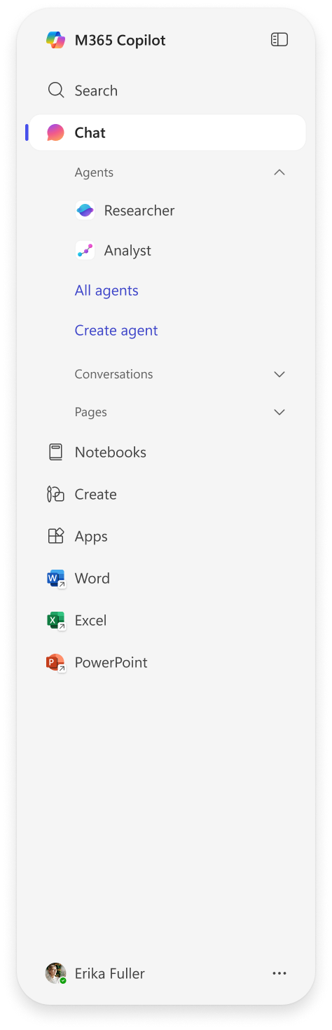

5 in 1 AI capabilities with M365 Copilot
2
1
3
1
2
3
Chat
Search
Agents
Secure AI chat powered by the latest models available and grounded in web and work data.
AI-powered search that spans all your work data for fast, accurate results.
A broad ecosystem of pre-built agents available in the Agent Store and build your own agents in Copilot Studio.
4
5
4
5
Notebooks
Create
Copilot is grounded in your project’s diverse content types to provide targeted responses and engaging audio overviews.
AI-generated images, posters, banners, videos, and more that are aligned to your organization’s brand identity.

Slide 20
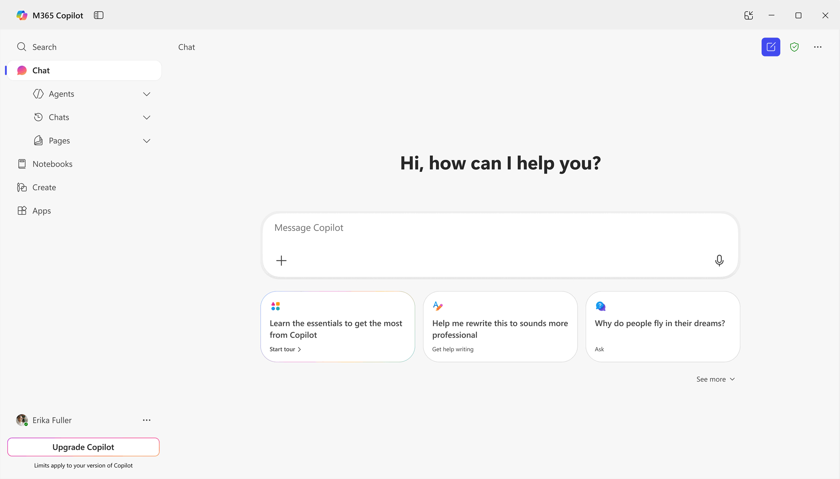
Chat
Secure AI chat powered
by the latest models available and grounded
in web and work data.
Notes:
Let’s start with Chat, which is grounded in both web and work data.
With Copilot Chat, you get personalized, context-aware support through natural language interactions, directly within your workflow, drawing from both the web and your work data. Get answers, stay updated, and create content—it’s all powered by advanced AI models and made secure with enterprise data protection. These interactions are personalized to your needs, drawing on previous chats, work profiles, and custom instructions. You can also invoke agents to automate tasks, such as performing research or generating reports. Or you can create a custom agents tailored to fit your unique needs - - more on that later.
You can transform Copilot responses into flexible pages designed for sharing, refining, and collaboration using Copilot Pages, which provides a durable space for real-time co-editing. You can then convert that content into other formats like Word for additional editing, distribution, or reuse.

Slide 21
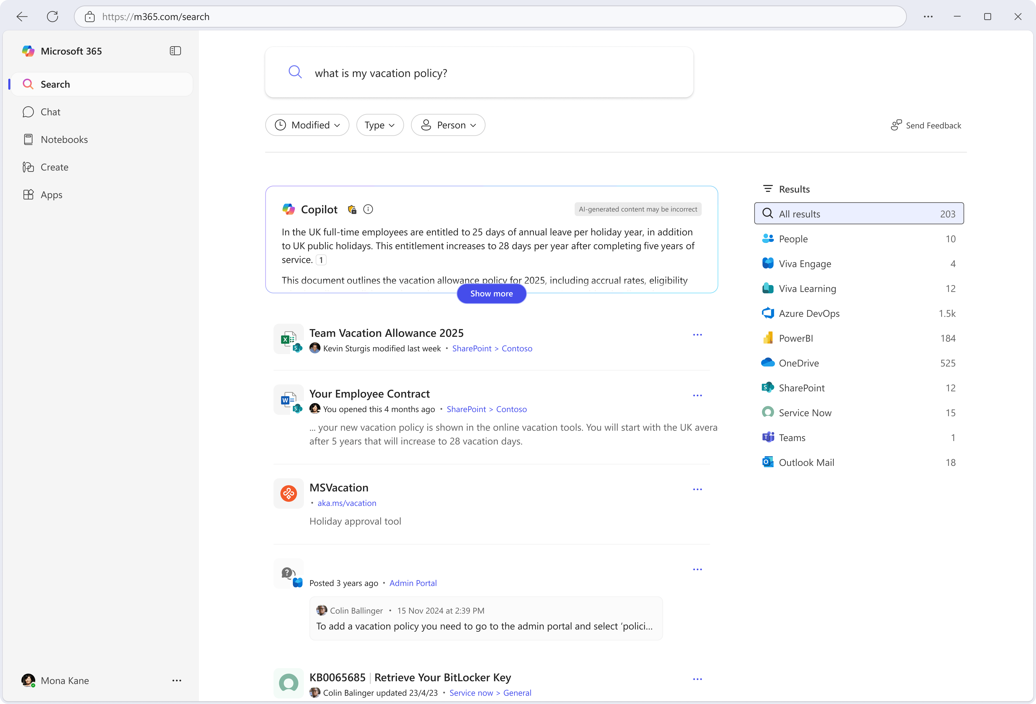
Search
AI-powered search that spans all your work data for fast, accurate results.
Notes:
Microsoft 365 Copilot Search is a search experience using Microsoft Graph that surfaces relevant work information that people use every day to help them complete tasks more easily, quickly, and effectively. It leverages the network of insights and information from the applications and services they use every day across Microsoft 365 and third-party applications.
For example, new semantic search capabilities built into Copilot Search enable semantic understanding for natural language queries. This means you can search using your own language across your information across Microsoft 365, on-premises and other cloud applications and services. Our extensive connector ecosystem helps to ensure you are able to find information that matters to you most, all while providing the control and trust you expect from Microsoft 365.
Copilot Search allows admins to curate answers that provide concise, authoritative results that are especially relevant to your organization.

Slide 22
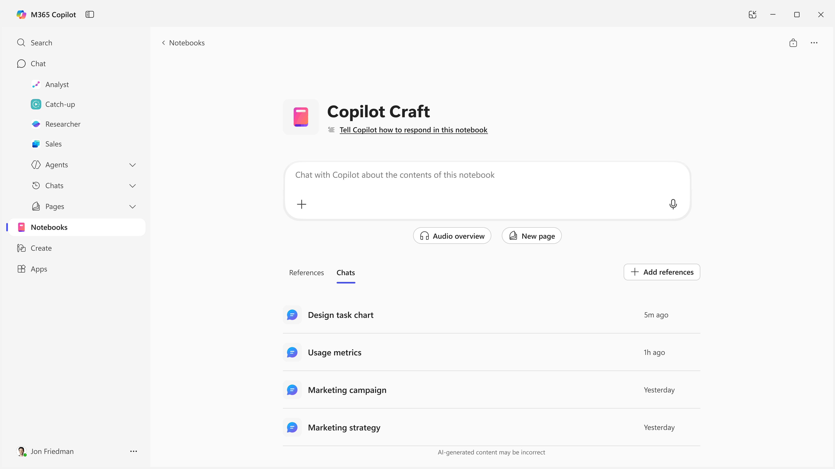
Notebooks
Centralize project-related content of various types. Copilot is grounded in that content to provide targeted AI assistance and creates engaging summaries with audio overviews.
Notes:
Copilot Notebooks allows you to pull together a wide range of content such as your notes, documents, websites, meeting recordings, and more. It then grounds Copilot on your notebook to give you the most relevant actions and insights—all while regularly scanning your source material to update in real time as your content updates. Notebooks can even create an audio overview of your content with two hosts that walk you through the key points—a fun, flexible way to stay informed.
When you start a Notebook, intelligent suggestions surfaced from your work data recommend content relevant to your Notebook’s topic and you can set instructions for Copilot to follow when delivering prompts.
As you create with Copilot, answers are focused on the content in your notebook, and you can continue adding content as your project evolves.
Notebooks empower users to accomplish anything from a small task to a larger project without leaving the Copilot app.
.

Slide 23
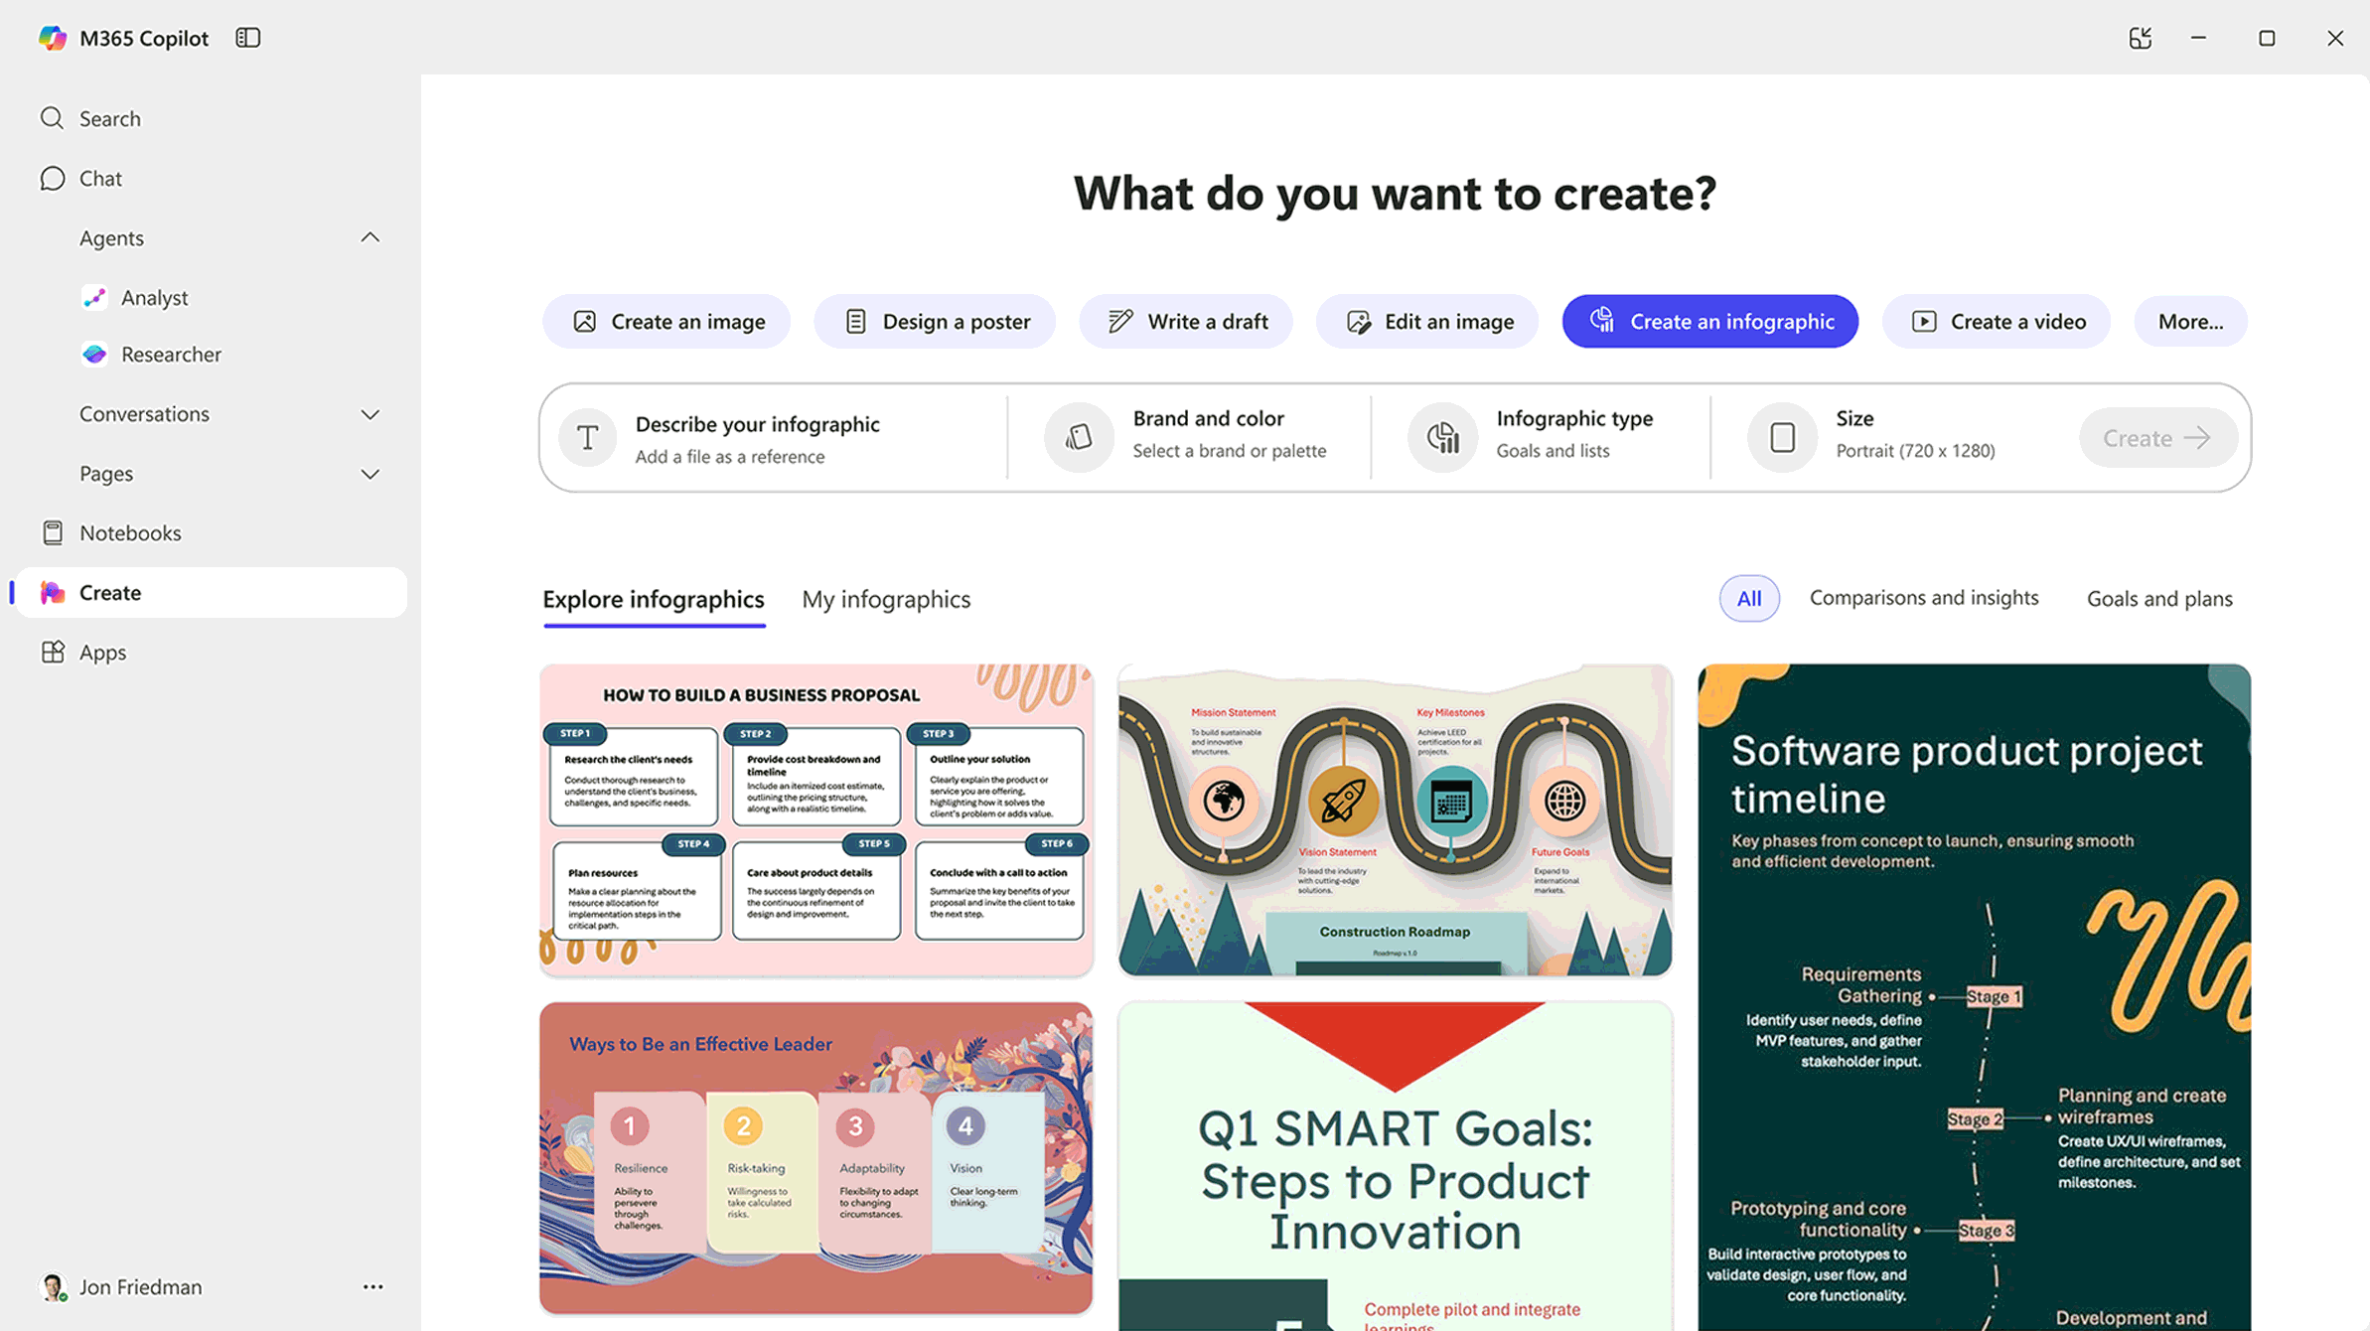
Create
AI-generated images, posters, banners, videos, and more that are aligned to your organization’s brand identity.
Notes:
Create helps you generate and edit a wide variety of content including visual artifacts (images, infographics, and banners), videos (scripting, stock or PPT visuals, audio, and voiceover), text artifacts (documents, FAQs, and newsletters), and surveys (including polls, quizzes).
You can choose from thousands of modern templates that help with inspiration or leverage your company’s branded templates as a starting point in your creation journey.
Powerful LLMs, such as GPT 4o for images, along with guidance from artifact suggestions and prompt templates, enables anyone to efficiently produce incredible content.
Create is grounded from the Microsoft Graph and files uploaded by you.

Slide 24
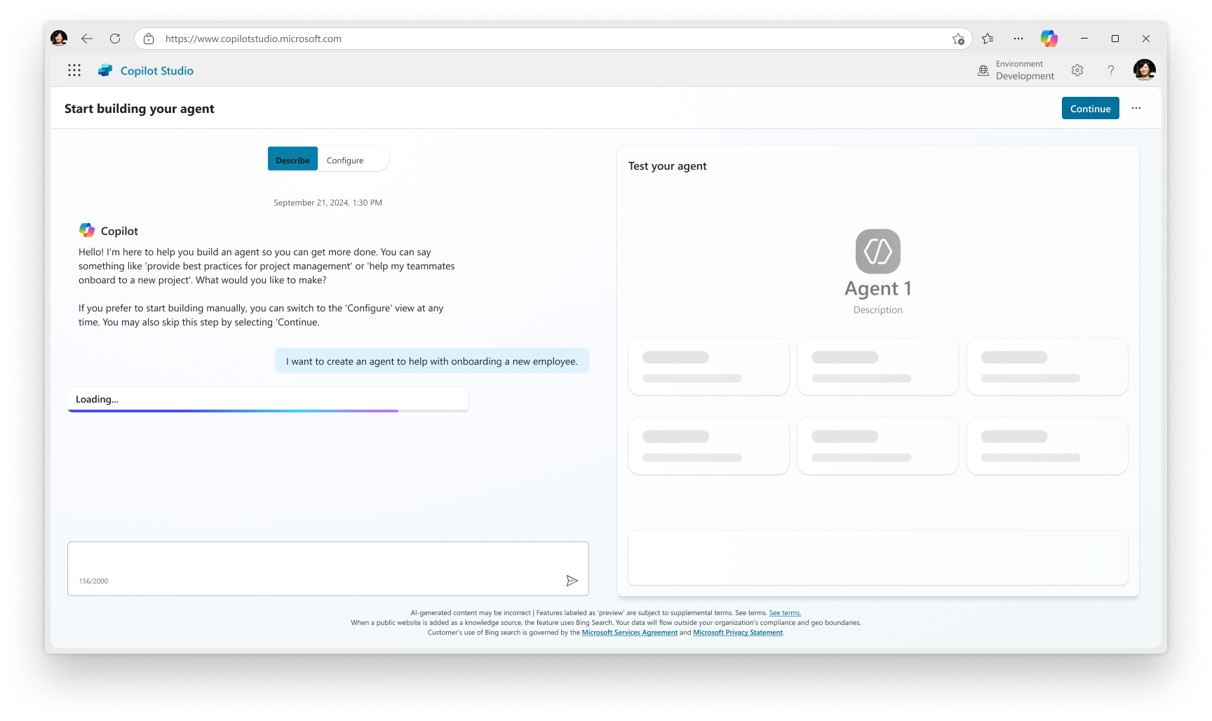
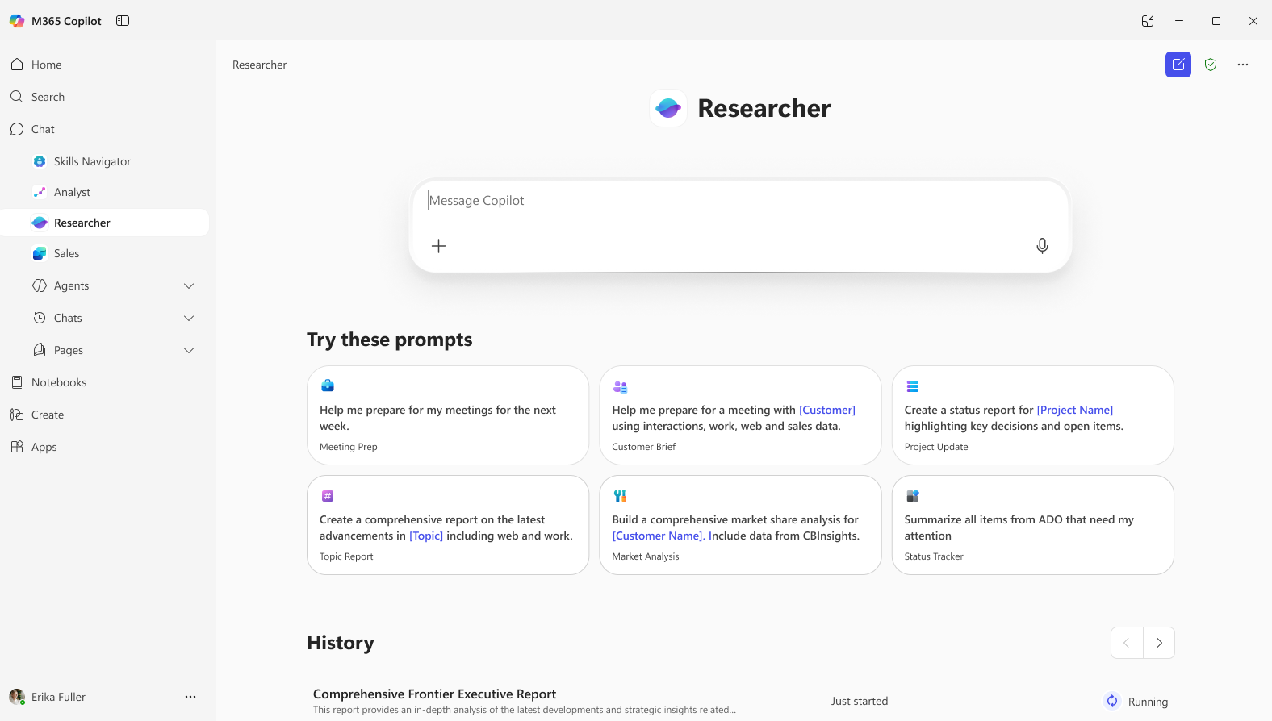
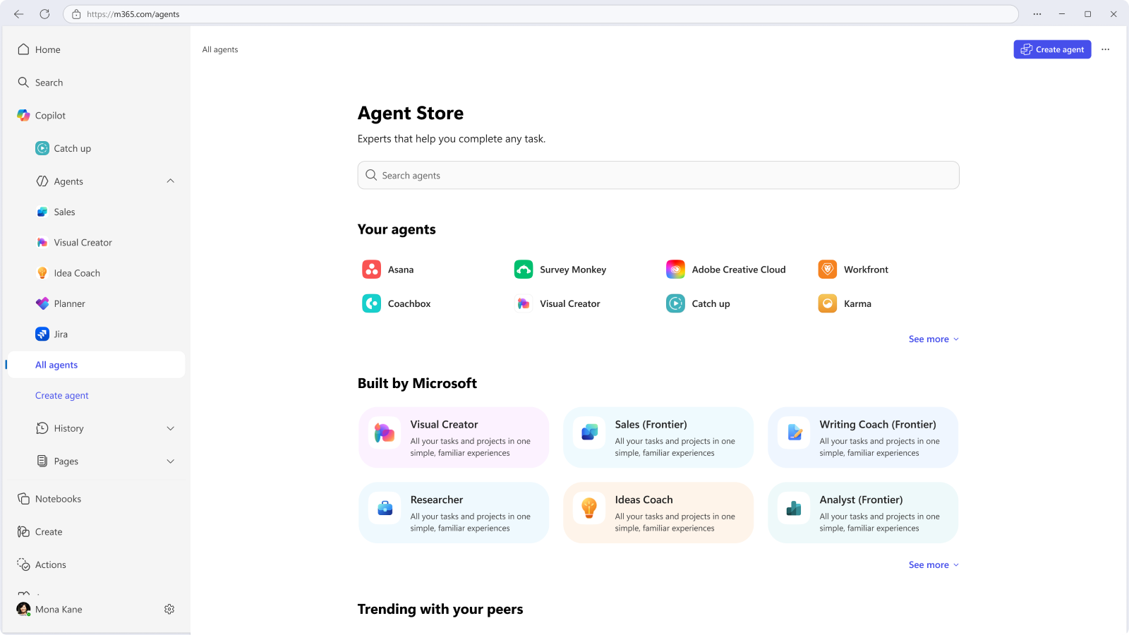
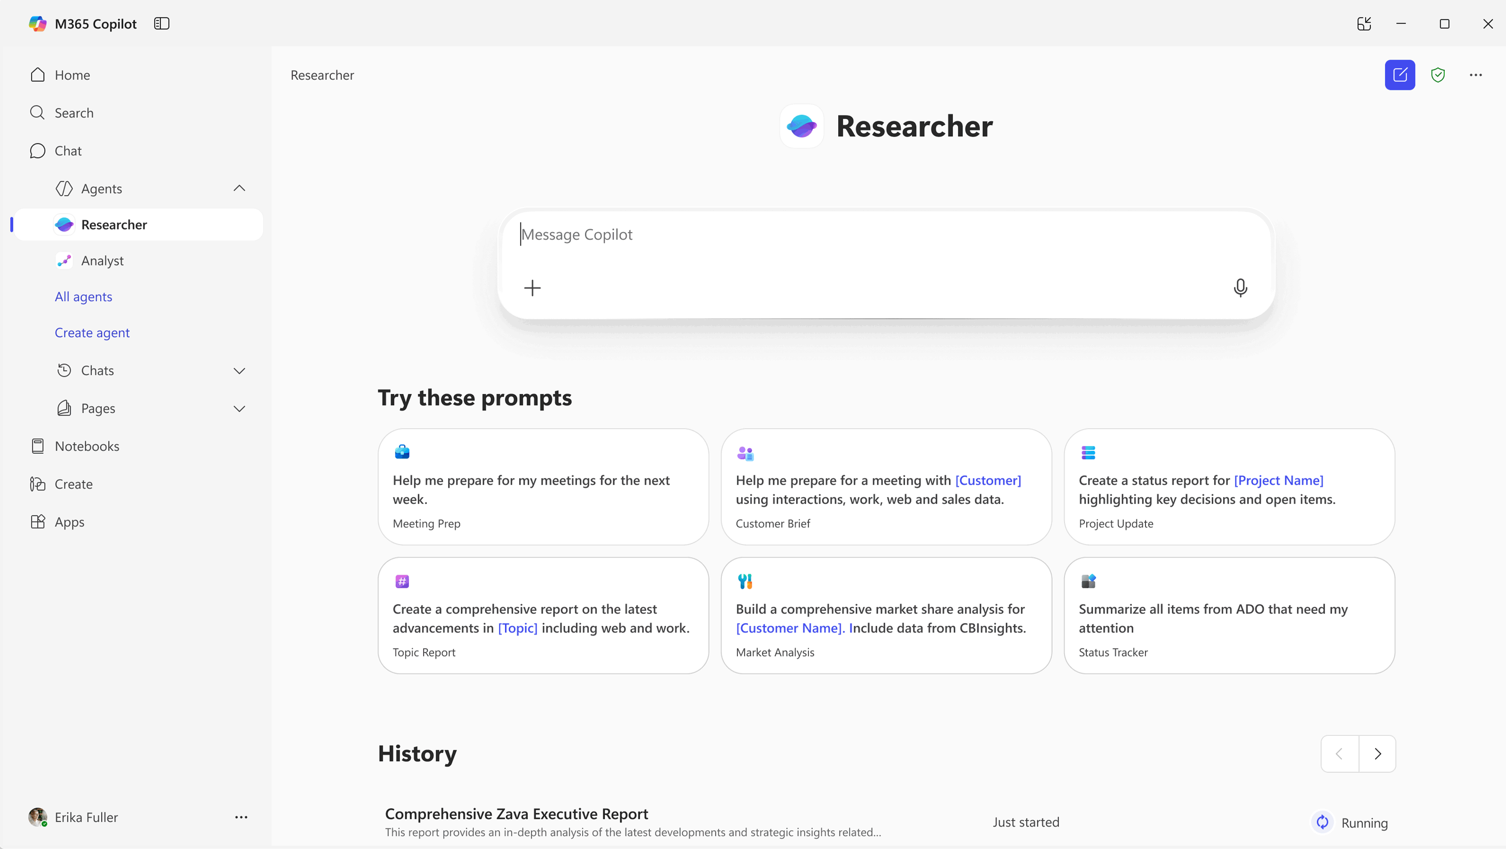
Agents
A broad ecosystem of pre-built agents available in the Agent Store and tools to build your own agents in Copilot Studio.
Notes:
Agents are intelligent tools that perform tasks on behalf of users. In Copilot, they’re available as pre-built solutions in the Agent Store or can be custom-built in Copilot Studio to meet specific needs.
They’re essential because they automate repetitive work, reduce errors, and accelerate decision-making. For individuals, they act as smart assistants; for organizations, they streamline operations and boost productivity.
Agents in Copilot stand out thanks to their deep Microsoft 365 integration, a rich library of ready-to-use agents, and powerful customization tools—making them the most flexible and enterprise-ready solution on the market.
The Copilot app allows you to discover, use, and create agents within the flow of your work, which can save you time by automating processes and working on your behalf.

Slide 25
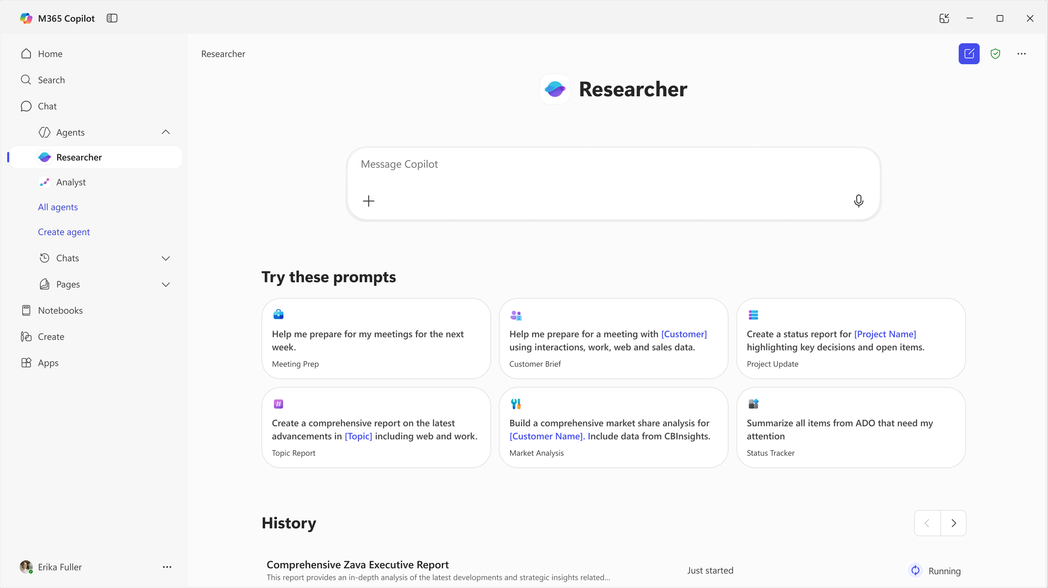
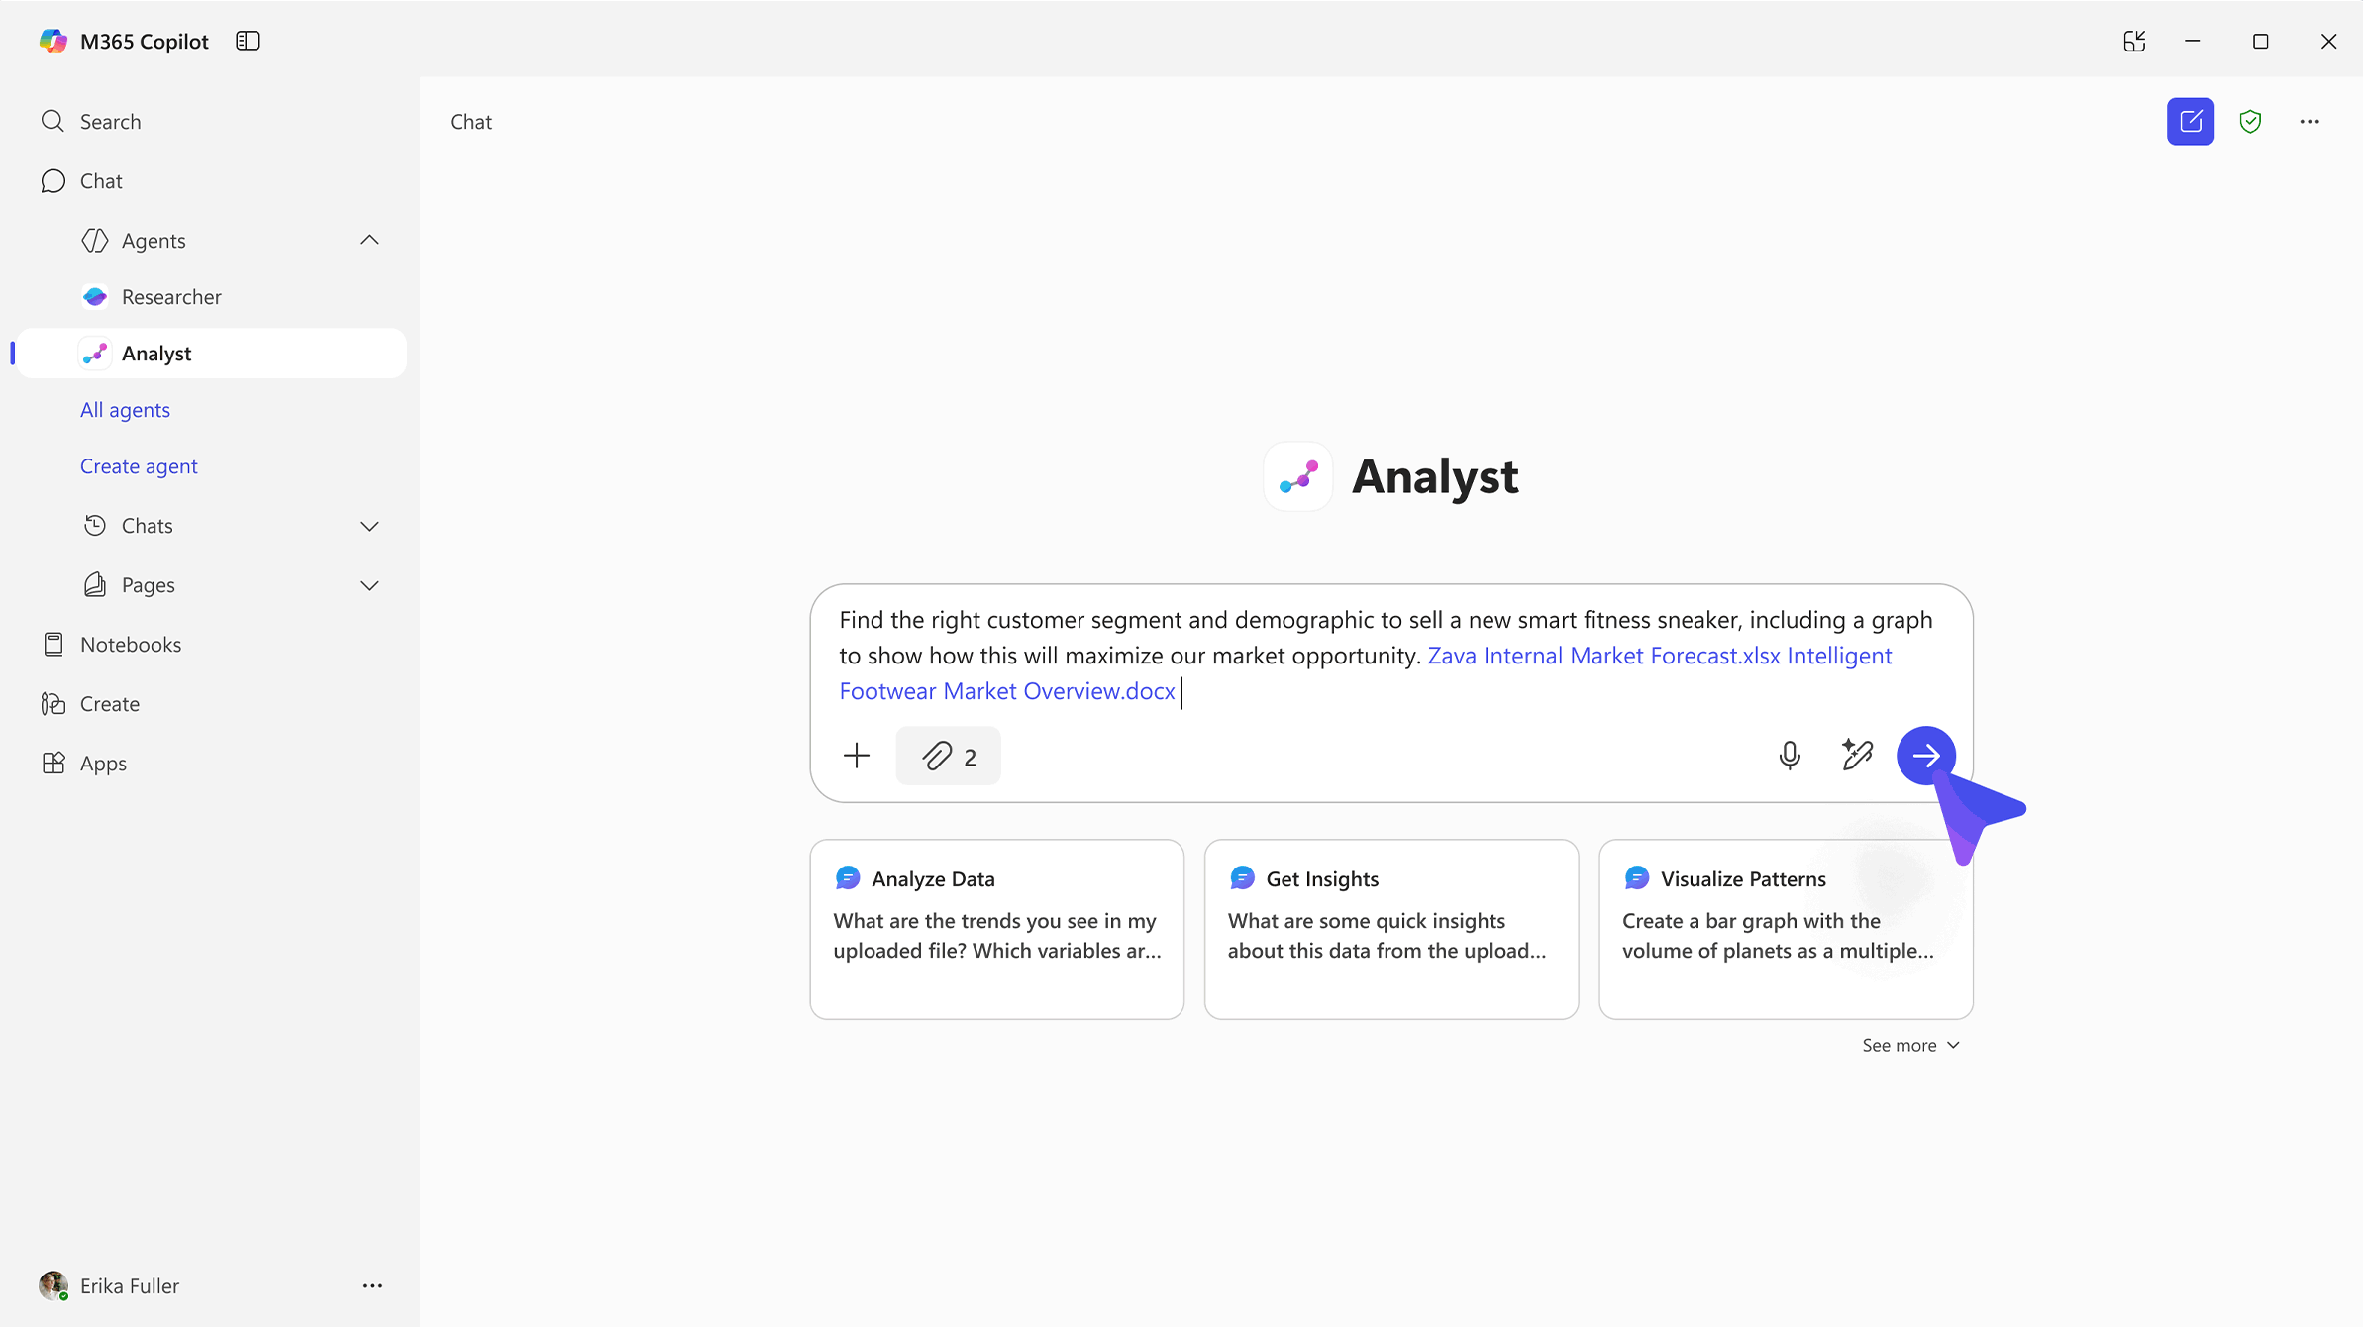
Researcher agent
Analyst agent
Tackles complex, multi-step
research with accuracy using
OpenAI’s deep research model and Microsoft 365 Copilot’s advanced orchestration and search.
Advanced reasoning agent that uses iterative chain-of-thought reasoning for advanced data analysis – turning raw data to insights in minutes with the power of OpenAI’s o3-mini model.
Notes:
Researcher agent combines the most advanced reasoning models with Copilot Chat's web and work-grounding capabilities, as well as other agents, to do in-depth reporting for organizations.
More specifically, it combines OpenAI’s deep research model with Microsoft 365 Copilot’s advanced orchestration and deep search capabilities to help users tackle complex, multi-step research at work.
Why does this matter? It helps organizations deliver insights with greater quality and accuracy than ever before.
The Researcher Agent gives organizations the capability they’d expect from a highly paid strategist or researcher.
By combining the most advanced deep reasoning models with Copilot Chat’s web- and work-grounding, as well as its agent ecosystem, this agent provides well-reasoned responses to complex prompts with the data that matters most.
For users, this gives them a thought partner that can perform advanced reasoning grounded in their unique context, and for an organizations this gives them on-demand access to the types of work they typically expect from highly paid employees.
Analyst agent is another first-of-its-kind reasoning agent for work that can help companies tackle complex data queries.
Powered by an advanced reasoning model that Microsoft has optimized for more in-depth data analysis, it gathers information and reasons through the data, using Python to generate a response.
Analyst works to analyze raw data and deliver results, so you can go from raw data to insights quickly.
Built on OpenAI’s o3-mini reasoning model and optimized to do advanced data analysis at work,
Analyst uses chain-of-thought reasoning to progress through problems iteratively, taking as many steps as necessary to refine its reasoning and provide a high-quality answer.
It can run Python to tackle your most complex data queries—and you can view the code it's running in real time to check its work.

Slide 26
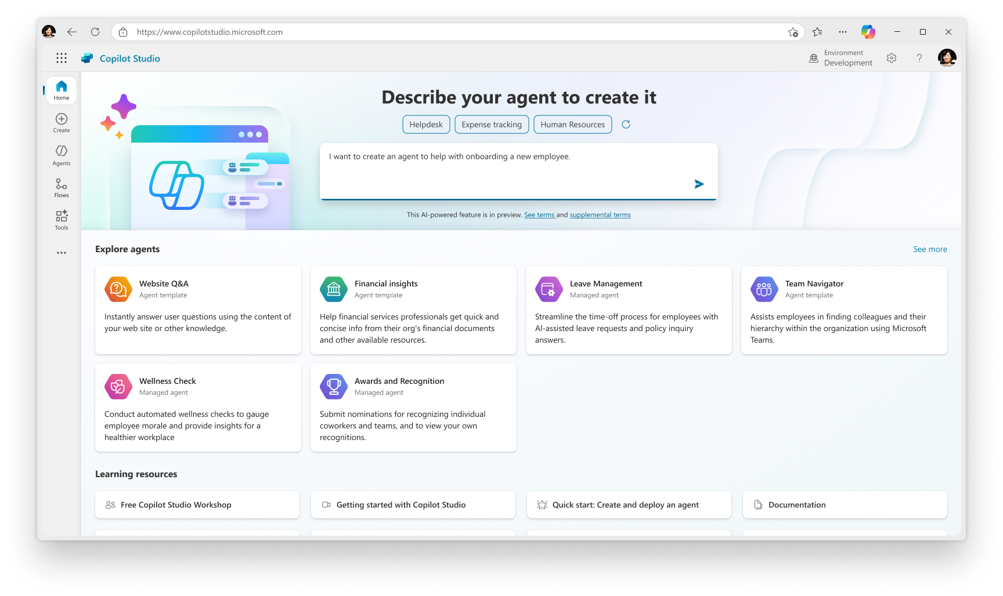
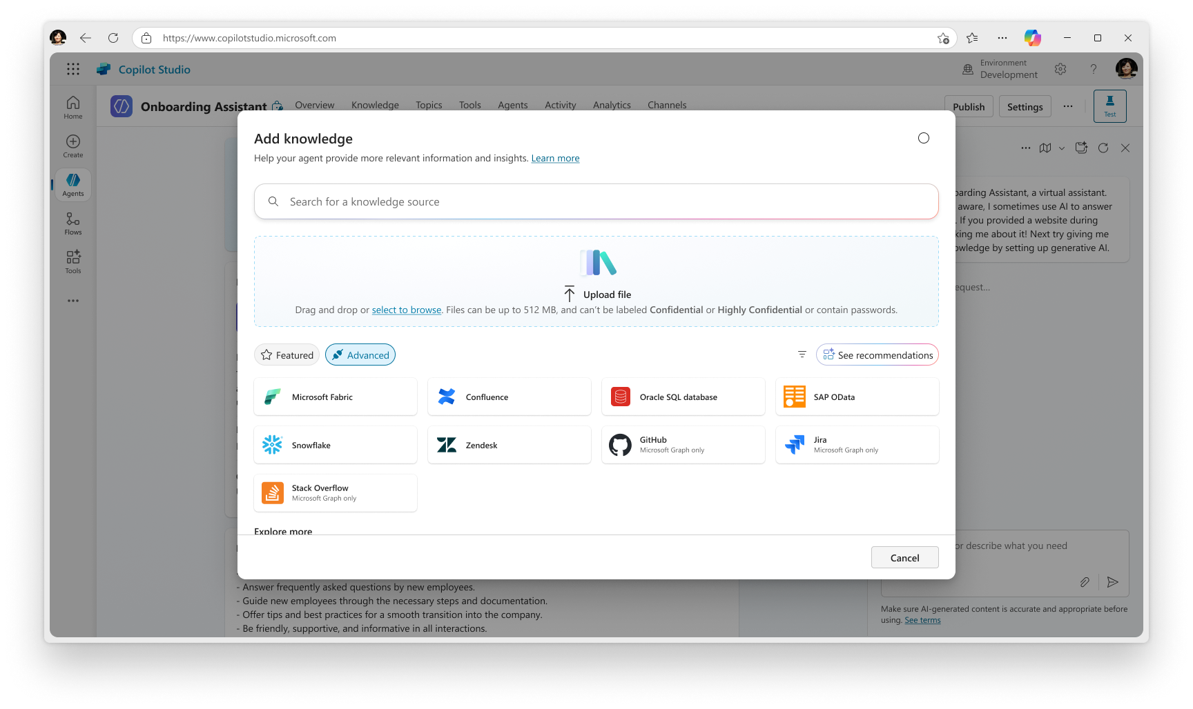
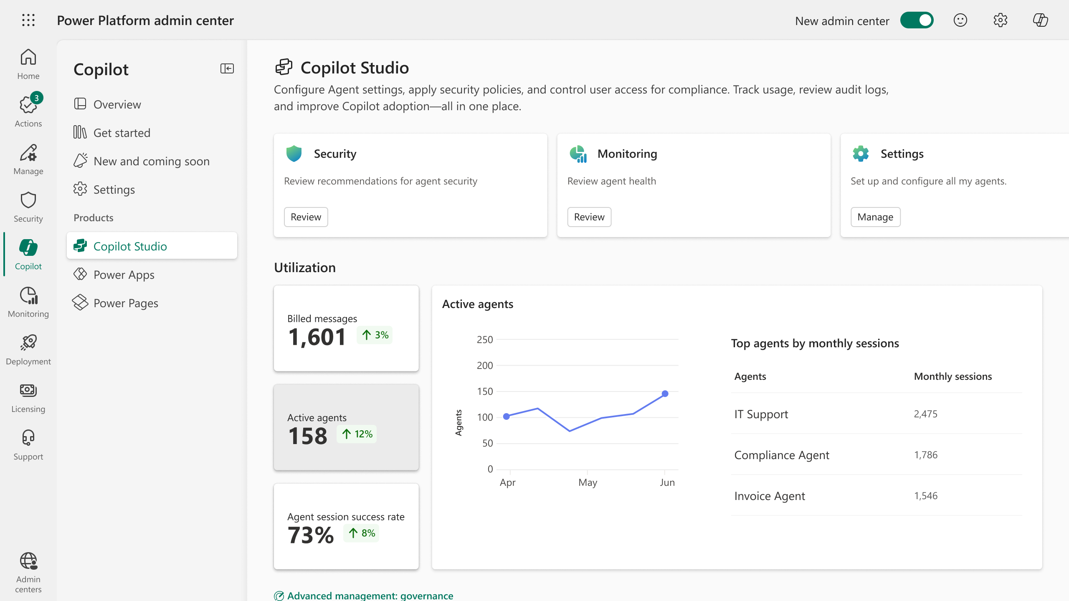
Copilot Studio
Build your own agents
Bring your own agent
Manage and secure at scale
Select from your choice of 1500+ connectors, data, actions, and channels to build an agent – from simple to sophisticated.
Build with Azure AI Foundry—your models, data, tools—and bring it
to Copilot Studio to create powerful, custom agents.
IT stays in charge of every
agent across the organization
with full visibility, security, and
compliance controls.
Notes:
Copilot Studio is our integrated Agent platform for building, customizing, and managing AI agents. It empowers agent makers to create intelligent assistants that automate tasks, answer questions, and integrate with enterprise systems.
Users can build agents using natural language or a visual editor, making it accessible to both developers and non-technical users.
It supports over 1,500 connectors and allows integration with internal systems like SAP, SharePoint, and Azure service.
The integration of Copilot Studio with Azure AI Foundry empowers developers and makers to build, customize, and deploy their own AI agents using Microsoft’s full AI stack.
Importantly, Copilot Studio gives IT full control over AI agents with enterprise-grade security and compliance. Admins can manage access, enforce DLP policies, monitor usage with audit logs, and ensure agents align with corporate standards—keeping deployments secure, compliant, and governed at scale.

Slide 27


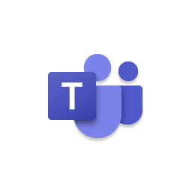


Microsoft Agents
Researcher
Analyst
Skills agent
Advanced reasoning
Advanced reasoning
Generally available
Generally available
Generally available
in July 2025
Facilitator
Sales agent
Project Manager
Public preview
Public preview
Public preview
Automate tasks with pre-built agents by Microsoft that are designed for work
Notes:
To help you get started, we’ve created “pre-built" agents in Microsoft 365 Copilot.
For example, you can use the project manager agent to help you track status and updates against a broader project plan. Or the Facilitator agent, which can help you run meetings in Teams more efficiently.
Let me show you a few examples.

Slide 28
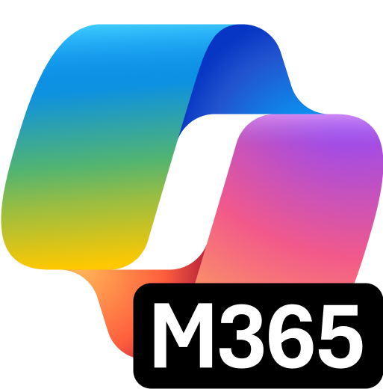


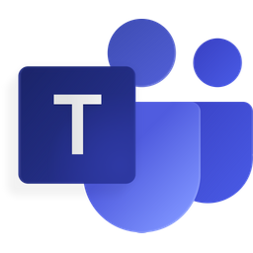







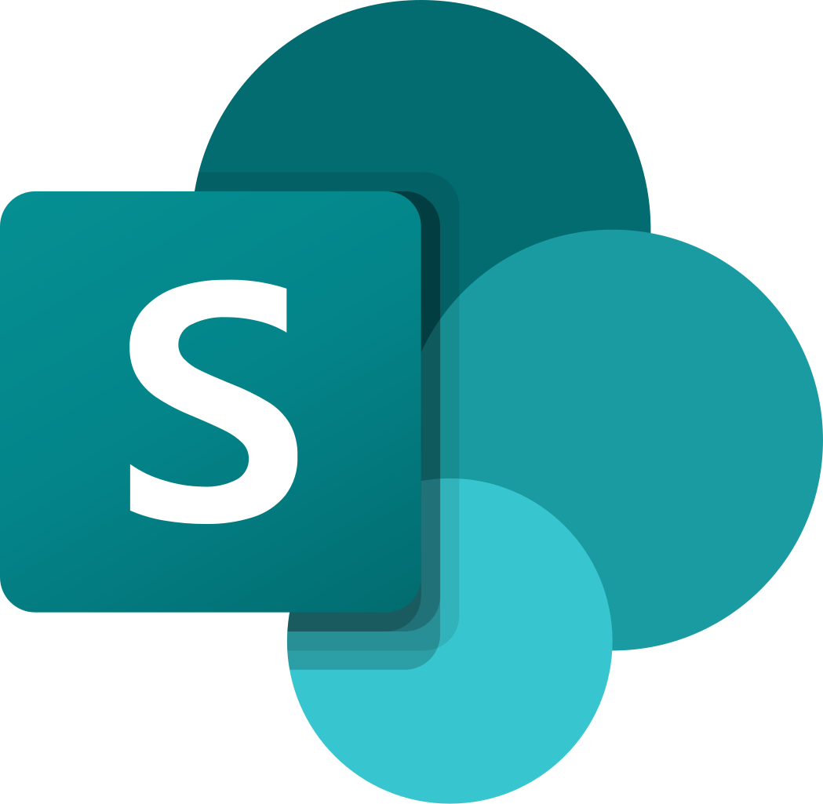







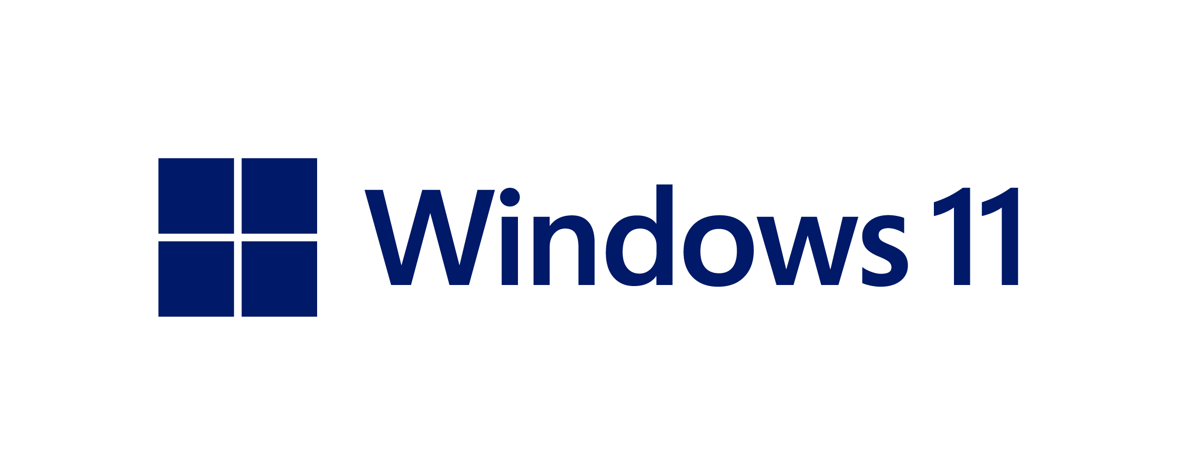
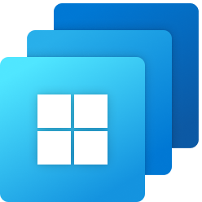




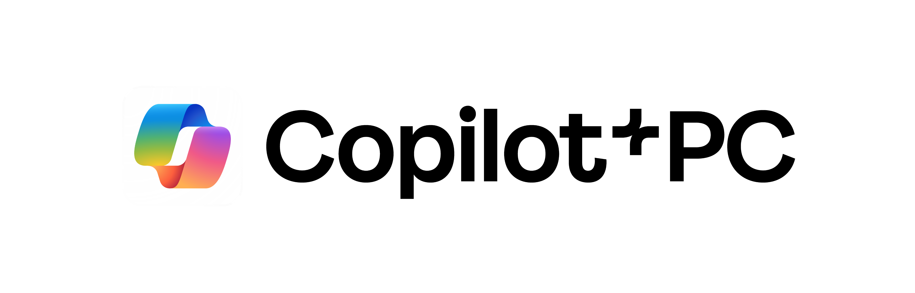
Microsoft AI Business Solutions
Microsoft 365
Copilot Studio
Dynamics 365
Outlook
Word
Teams
PowerPoint
Sales
Commerce
Finance
Field
Service
Customer Insights
Excel
SharePoint
Defender
Intune
Copilot Studio
Project
Operations
Contact
Center
Customer
Service
Supply Chain Management
Windows
Power Platform
Windows 365
Power Apps
Power Automate
Power Pages
Power BI
Agents designed for work
Notes:
We offer a Comprehensive set of solutions for transforming your business with AI
M365 copilot is your complete AI assistant for work which recently has been upgraded with new 5-in- capabilities.
Microsoft 365 provides organizations get a unified solution that helps teams stay productive, collaborate securely, and embrace AI-powered work.
Windows provides a standardized framework for AI agents to connect with native Windows apps
Copilot Studios empowers everyone with tools to build custom agents and low code tools for creating AI-powered apps, portals, and enterprise-grade automation.
Dynamics 365 reinvents CRM and ERP for a new era of agentic business processes--the only suite of connected, AI and agent-infused applications that help you personalize customer experiences and boost operational agility and efficiency. You can extend and customize Dynamics with Power Platform’s low code tools.

Slide 29



Dynamics 365
the leading agentic CRM and ERP business applications
Service
Customer Experience
Operations
Contact Center
Customer Service
Sales
Finance
Supply Chain Management
Contact center
as a service
Customer relationship management
Revenue forecast
and acceleration
Financial
management
Supply chain, warehouse, asset management
Generative AI
Unified
Agents
Collaborative
Extensible
Built in and included
in premium SKUs
Dataverse as one
common data model
Supporting end-to-end business processes
Seamlessly integrated with Microsoft 365 and Teams
Embedded low code for innovation and automation
Notes:
As you unlock the value of AI and agents across your organization, you need specialized solutions for every function. Dynamics 365 is one of the best ways to accelerate your AI transformation across sales, service, finance, supply chain and other areas of your business.
Dynamics 365 reinvents CRM and ERP for a new era of agentic business processes--the only suite of connected, AI and agent-infused applications that help you personalize customer experiences and boost operational agility and efficiency. Dynamics 365 seamlessly connects with Microsoft 365, Power Platform, and Copilot Studio to customize agentic processes and unite people, insights, and processes across every line of business.
AI-powered productivity: Dynamics 365 is the only platform that natively integrates Copilot—the UI for AI—to automate tasks, generate ideas, and get insights from business and customer activities.
Unified data: Get a complete picture of your entire business by connecting and accessing organizational data from hundreds of sources. It’s a unified, scalable and secure enterprise data platform primed for AI-powered processes and intelligent automation—all built on a global Azure cloud footprint.
Agents: Dynamics 365 reinvents CRM and ERP with Prebuilt and customizable agents that support end-to-end business processes.
Collaborative: Dynamics seamlessly integrates with Microsoft 365 and Teams
Extensible: Power Platform integrates with Dynamics 365 to help you leverage business data to make informed data-driven decisions, streamline processes with automation and easily build custom apps. For example, Power Automate can automate tasks across your Dynamics 365 solution and you can create Power Apps that connect to the same data sources as Dynamics 365.

Slide 30

Extend your business applications with low-code tools
Power Platform
Power Apps
Power Automate
Power Pages
Power BI
Web and mobile
app development
Process and workflow
automation
Secure, data-centric business websites
Data exploration,
analytics and reporting
Boost efficiency with intelligent automation
One platform for your app, automation, bot, RPA and BI
Enhance experiences
with agentic apps
Create personalized, interactive apps that improve user engagement and satisfaction
Extensible
Easily customize with your favorite dev tools
Scale with a trusted and secure platform
Rely on robust security to grow your solutions and protect your data
Notes:
You can extend Dynamics 365 with Power Platform’s low code tools. Power Platform is the world’s leading AI and low-code platform, empowering everyone at your organization with an intuitive, collaborative, and extensible platform of low-code tools that makes it easy to create efficient and flexible solutions.
Microsoft Power Platform is designed to empower anyone in your organization from business analysts and front line workers to professional developers to rapidly build new solutions that can meet digital demand by filling business process gaps. Simultaneously, Power Platform is a managed cloud SaaS solution built on top of Microsoft Azure meaning that it is built on planet leading security and easy to manage governance capabilities.
With Power Platform, your organization can:
Scale enterprise innovation with the most complete low code platform. Low-code solutions rapidly transform processes, integrating intelligent automation to boost efficiency.
Accelerate app development to drive innovation and productivity. Agentic apps personalize and engage user experiences, crucial for customer satisfaction.
And support hyperautomation to optimize for efficiency and reduce costs. A secure platform ensures confident scaling with protected data. The Power Platform's automation streamlines workflows, reduces manual tasks, and drives productivity.

Slide 31






Red thread: security foundation at Zava
Zava discovers competitive threat; adjusts launch strategy for ZavaCore
The dev team quickly ideates and prototypes
a new app for marketing to test
Finance uses agents to automate the period close process
R&D uses Azure for visualization and agentic interaction with data
Security
Foundation
at
M365 Copilot
Copilot
Studio
GitHub
Azure AI
Foundry
Dynamics 365
Microsoft
Fabric
Microsoft
Azure
Zava’s GTM team builds the launch plan with the help of agents
The dev team refines the app and hardens
for scale
R&D uses a digital twin in Fabric to iterate, innovate and monitor performance
Notes:
But most importantly, if you think about everything you saw from left to right, this is a story that only Microsoft can tell.
Yes, Zava is a fictitious company, but the scenarios we highlighted are scenarios that real world customers live through each and every day, using the technology we showed today.
We’re providing everything you see across this single red thread, that goes from Copilot to Studio to GitHub to Azure AI foundry to Dynamics, Fabric, and of course our security platform and everything that Azure provides to enable end-to-end AI transformation and empowering organizations to become frontier.

Slide 32
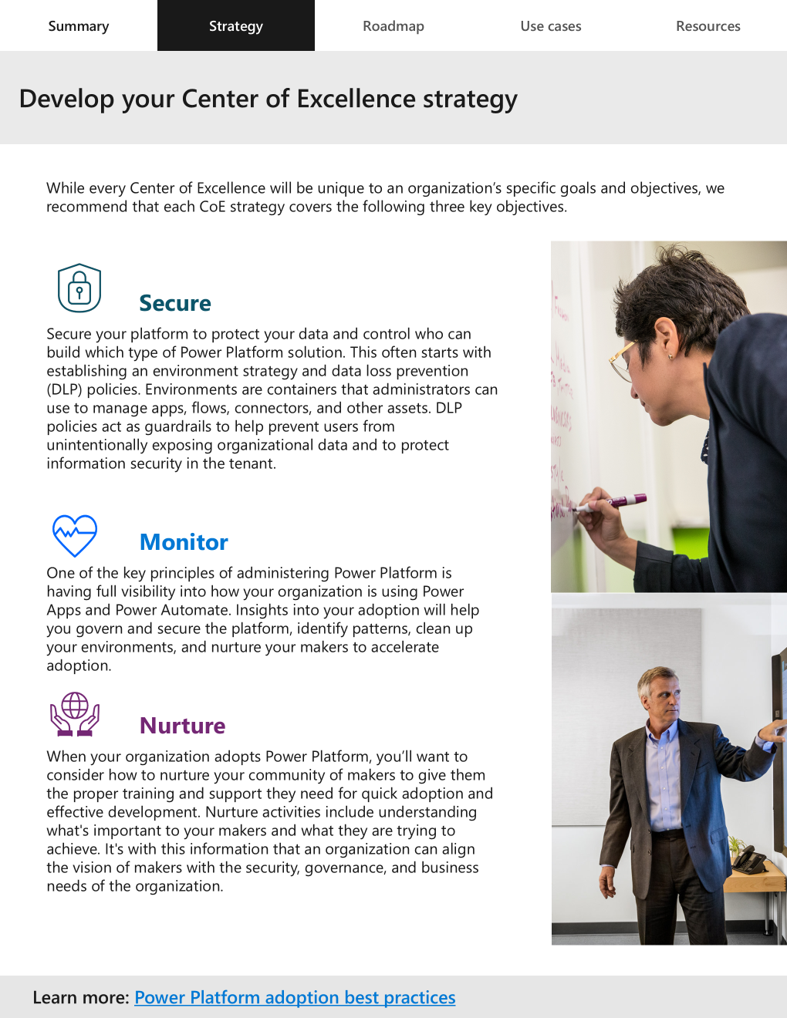
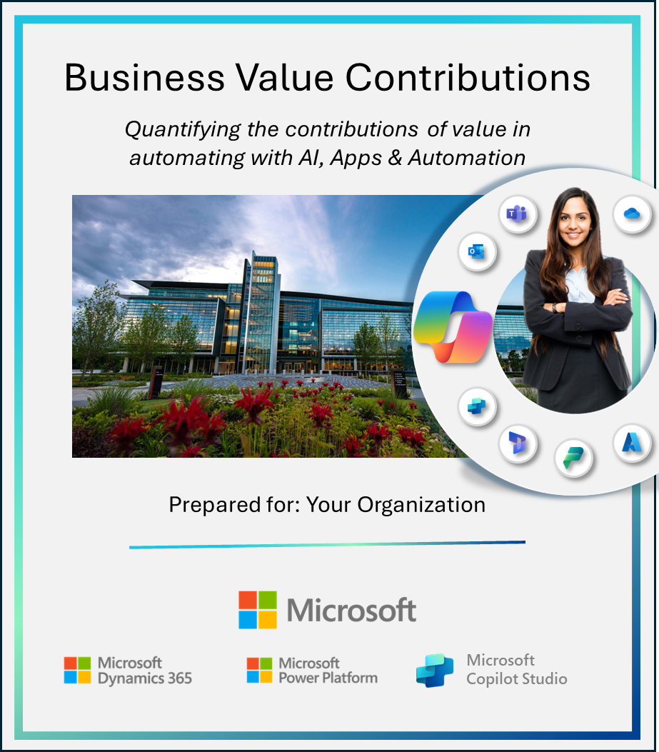
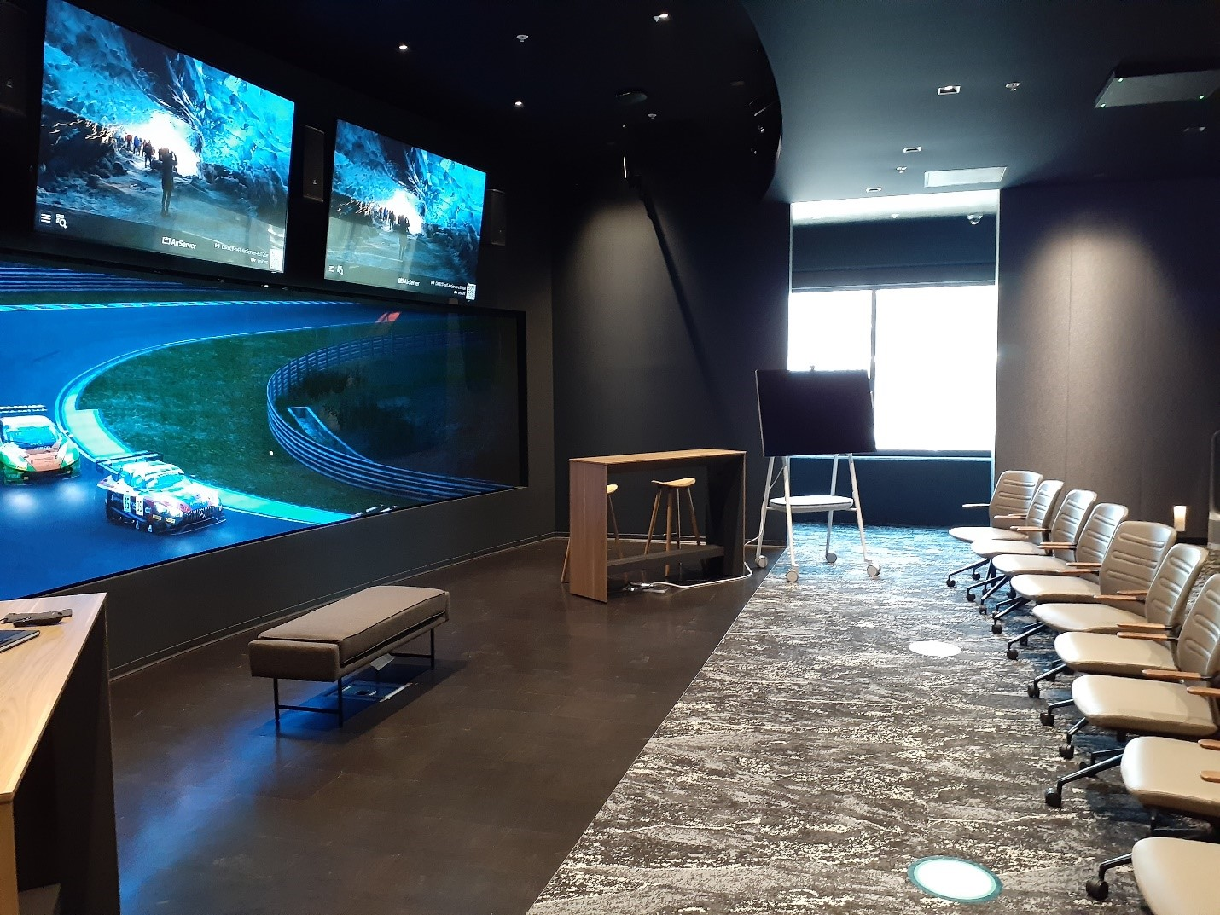
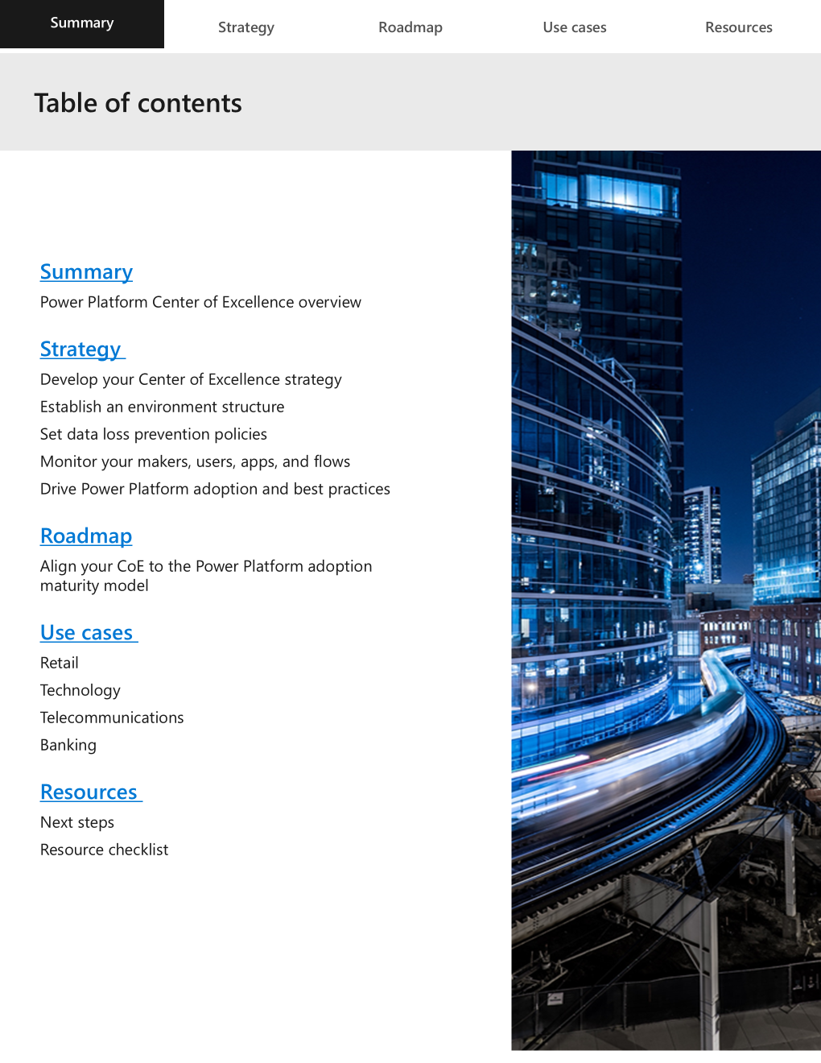
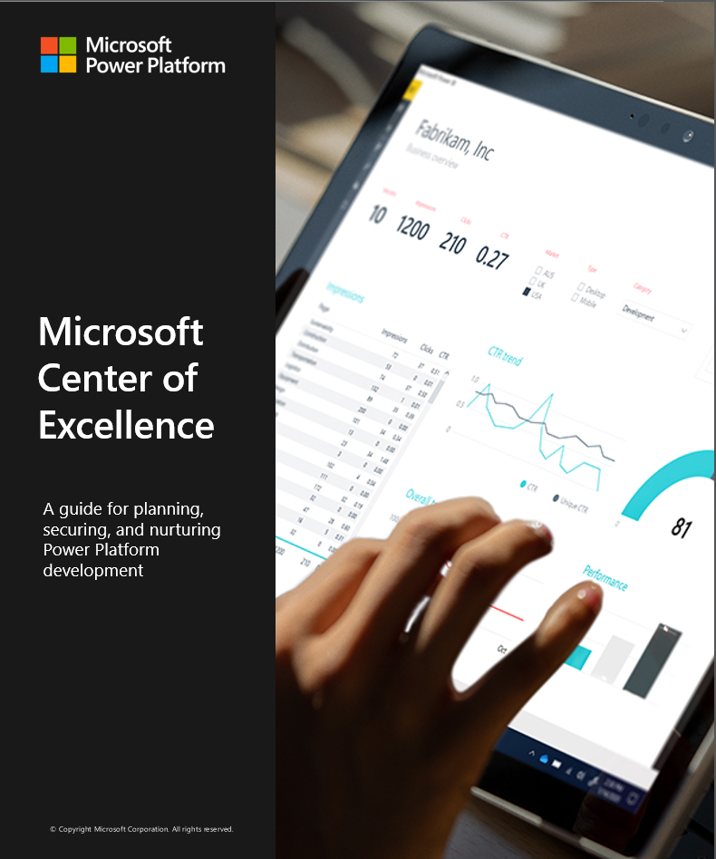




Your Success Path Forward | Becoming Frontier
Innovation Hub
Assess Contributions & Value
Envision Value & Transformation
Adopt & Accelerate
Quantify the value of your business transformation, the case for change and technological impact.
Imagine what the future state of your business could look like and define your Gen AI transformation journey.
Ensure buy-in across your organization with a Center of Excellence tailored for your success.
Contact
microsoft.com/hub
adoption.microsoft.com

Slide 33
Success Resources
Agent Adoption with Copilot Studio
Training, Scale & Communities
Customer Success Resources
AI Webinars – aka.ms/PowerCAT/AIWebinars
Power Up for Individuals & Groups – aka.ms/PowerUp
Power Up for Enterprise – aka.ms/PowerUpMyTeam
Agentic Workshops – aka.ms/kickstarteragenticworkshops
Agent in a Day – aka.ms/AGIAD
Agent Academy – aka.ms/Agent-Academy
Architecture Bootcamp – aka.ms/CopilotStudioBootcamp
Customer Hackathons – aka.ms/Register4AgentBAT/
Public Community Forum – aka.ms/CopilotStudioCommunity
Subreddit – aka.ms/CopilotStudioReddit
Product Documentation – aka.ms/CopilotStudioDocs
Product Guidance – aka.ms/CopilotStudioGuidance
Implementation Guide – aka.ms/MCSIG
Samples – aka.ms/CopilotStudioSamples
Copilot Studio Kit – aka.ms/CopilotStudioKit
What's new in Copilot Studio – aka.ms/MCSWhatsNew
Release Plans and Roadmap – aka.ms/CopilotStudioRoadmap
Licensing Guide – aka.ms/MCSLicensingGuide
Full list available here: https://aka.ms/BecomingFrontierMS
Notes:
AI is reshaping organizations into Frontier Firms—companies powered by human-agent teams, intelligence on tap, and dynamic, outcome-driven structures that scale rapidly and operate with agility.
Human-agent collaboration is redefining roles—with agents automating workflows and employees evolving into “agent bosses” who delegate, manage, and optimize digital labor to amplify impact.
AI literacy and skilling are now critical workforce strategies—as companies prioritize upskilling, agent management, and hiring for AI-specific roles to stay competitive in a rapidly transforming labor market.
AI is driving a shift in organizational design—from rigid hierarchies to fluid, team-based structures where decision-making and innovation are accelerated by real-time data and intelligent systems.

Slide 34


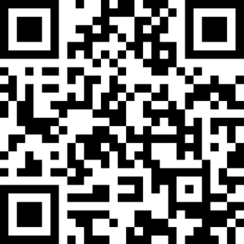
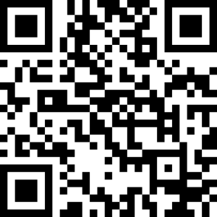



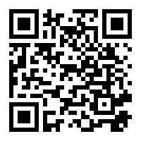
Save the date!
October 27th
Luncheon, Sessions, Tour & Reception
MGM Grand, Las Vegas
October 28th – 30th 2025
MGM Grand, Las Vegas
September - November
Various Cities
Notes:
Speaking of the PPCC,
We encourage you to save the date for that conference, now recognized as the largest AI and Low Code conference on the planet with an estimate 8000 participants this year,
We will be having a special event the day before PPCC just for the T&H Industry - this is meant to be a community immersion event including a networking luncheon with special keynotes, customer panel, and interactive tours. This is by application only as there is a limited number of seats available - please use this QR Code to nominate.

Slide 35
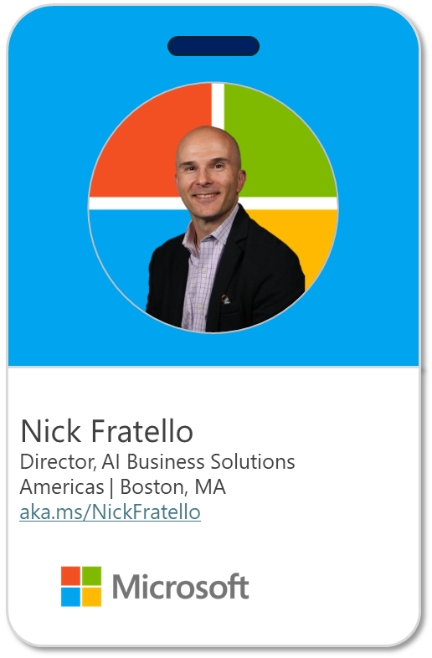
Thank You
  Becoming
  Frontier
Today’s presentation available here:
aka.ms/BecomingFrontierMS

