Slide 1
Mastering Copilot Studio with Generative Orchestration, Component Collections, and Azure AI Search
Dewain Robinson
Principal Copilot Architect – Copilot Studio

Slide 2
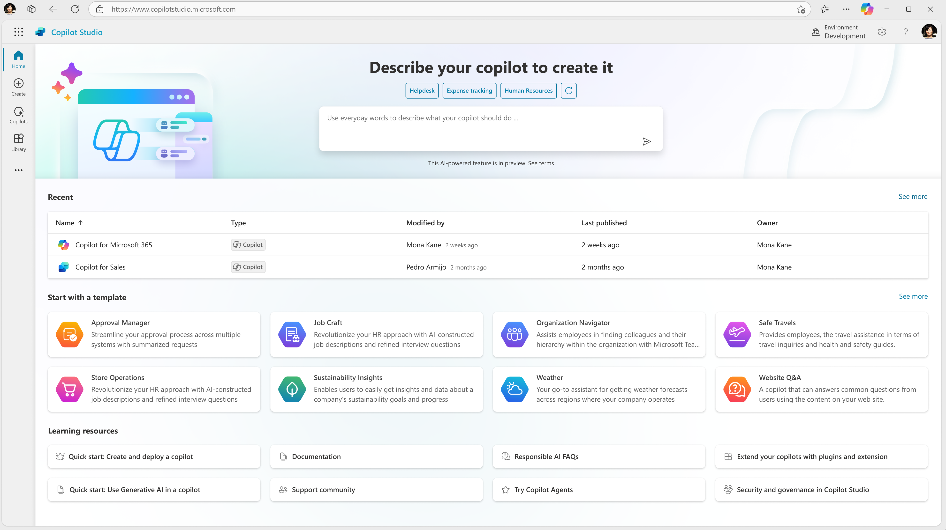
Announcement slide (dark) with color rotation
Microsoft Copilot Studio
Your agent, your way
Copilot Studio is an end-to-end conversational AI product for
building your own agent or extending Microsoft Copilot with generative AI, large language models and your data.
Notes:
Dewain

Slide 3
Custom agents

Slide 4
Major Components of Copilot Studio
Topics
Custom authored experiences that allows the maker to be in full control of every aspect of the conversation
Knowledge
SaaS-based RAG pattern for search and summarization of content, however it can be orchestrated unlike common RAG patterns
Actions
Conversational wrappers over APIs through Power Platform Connectors and Power Automate Flows allowing Generative AI to provide abilities to collect API Inputs and Generate Outputs dynamically
Analytics
E2E telemetry and reporting on conversations, audit, and application performance
Channels
Ability to connect conversational applications to numerous interfaces through channels such as Teams, Web Chat, Facebook Messenger, and etc
Variables
Ability to store conversation state and information into memory to be programably accessed through the conversation and to adapt the conversation
Notes:
Marius

Slide 5
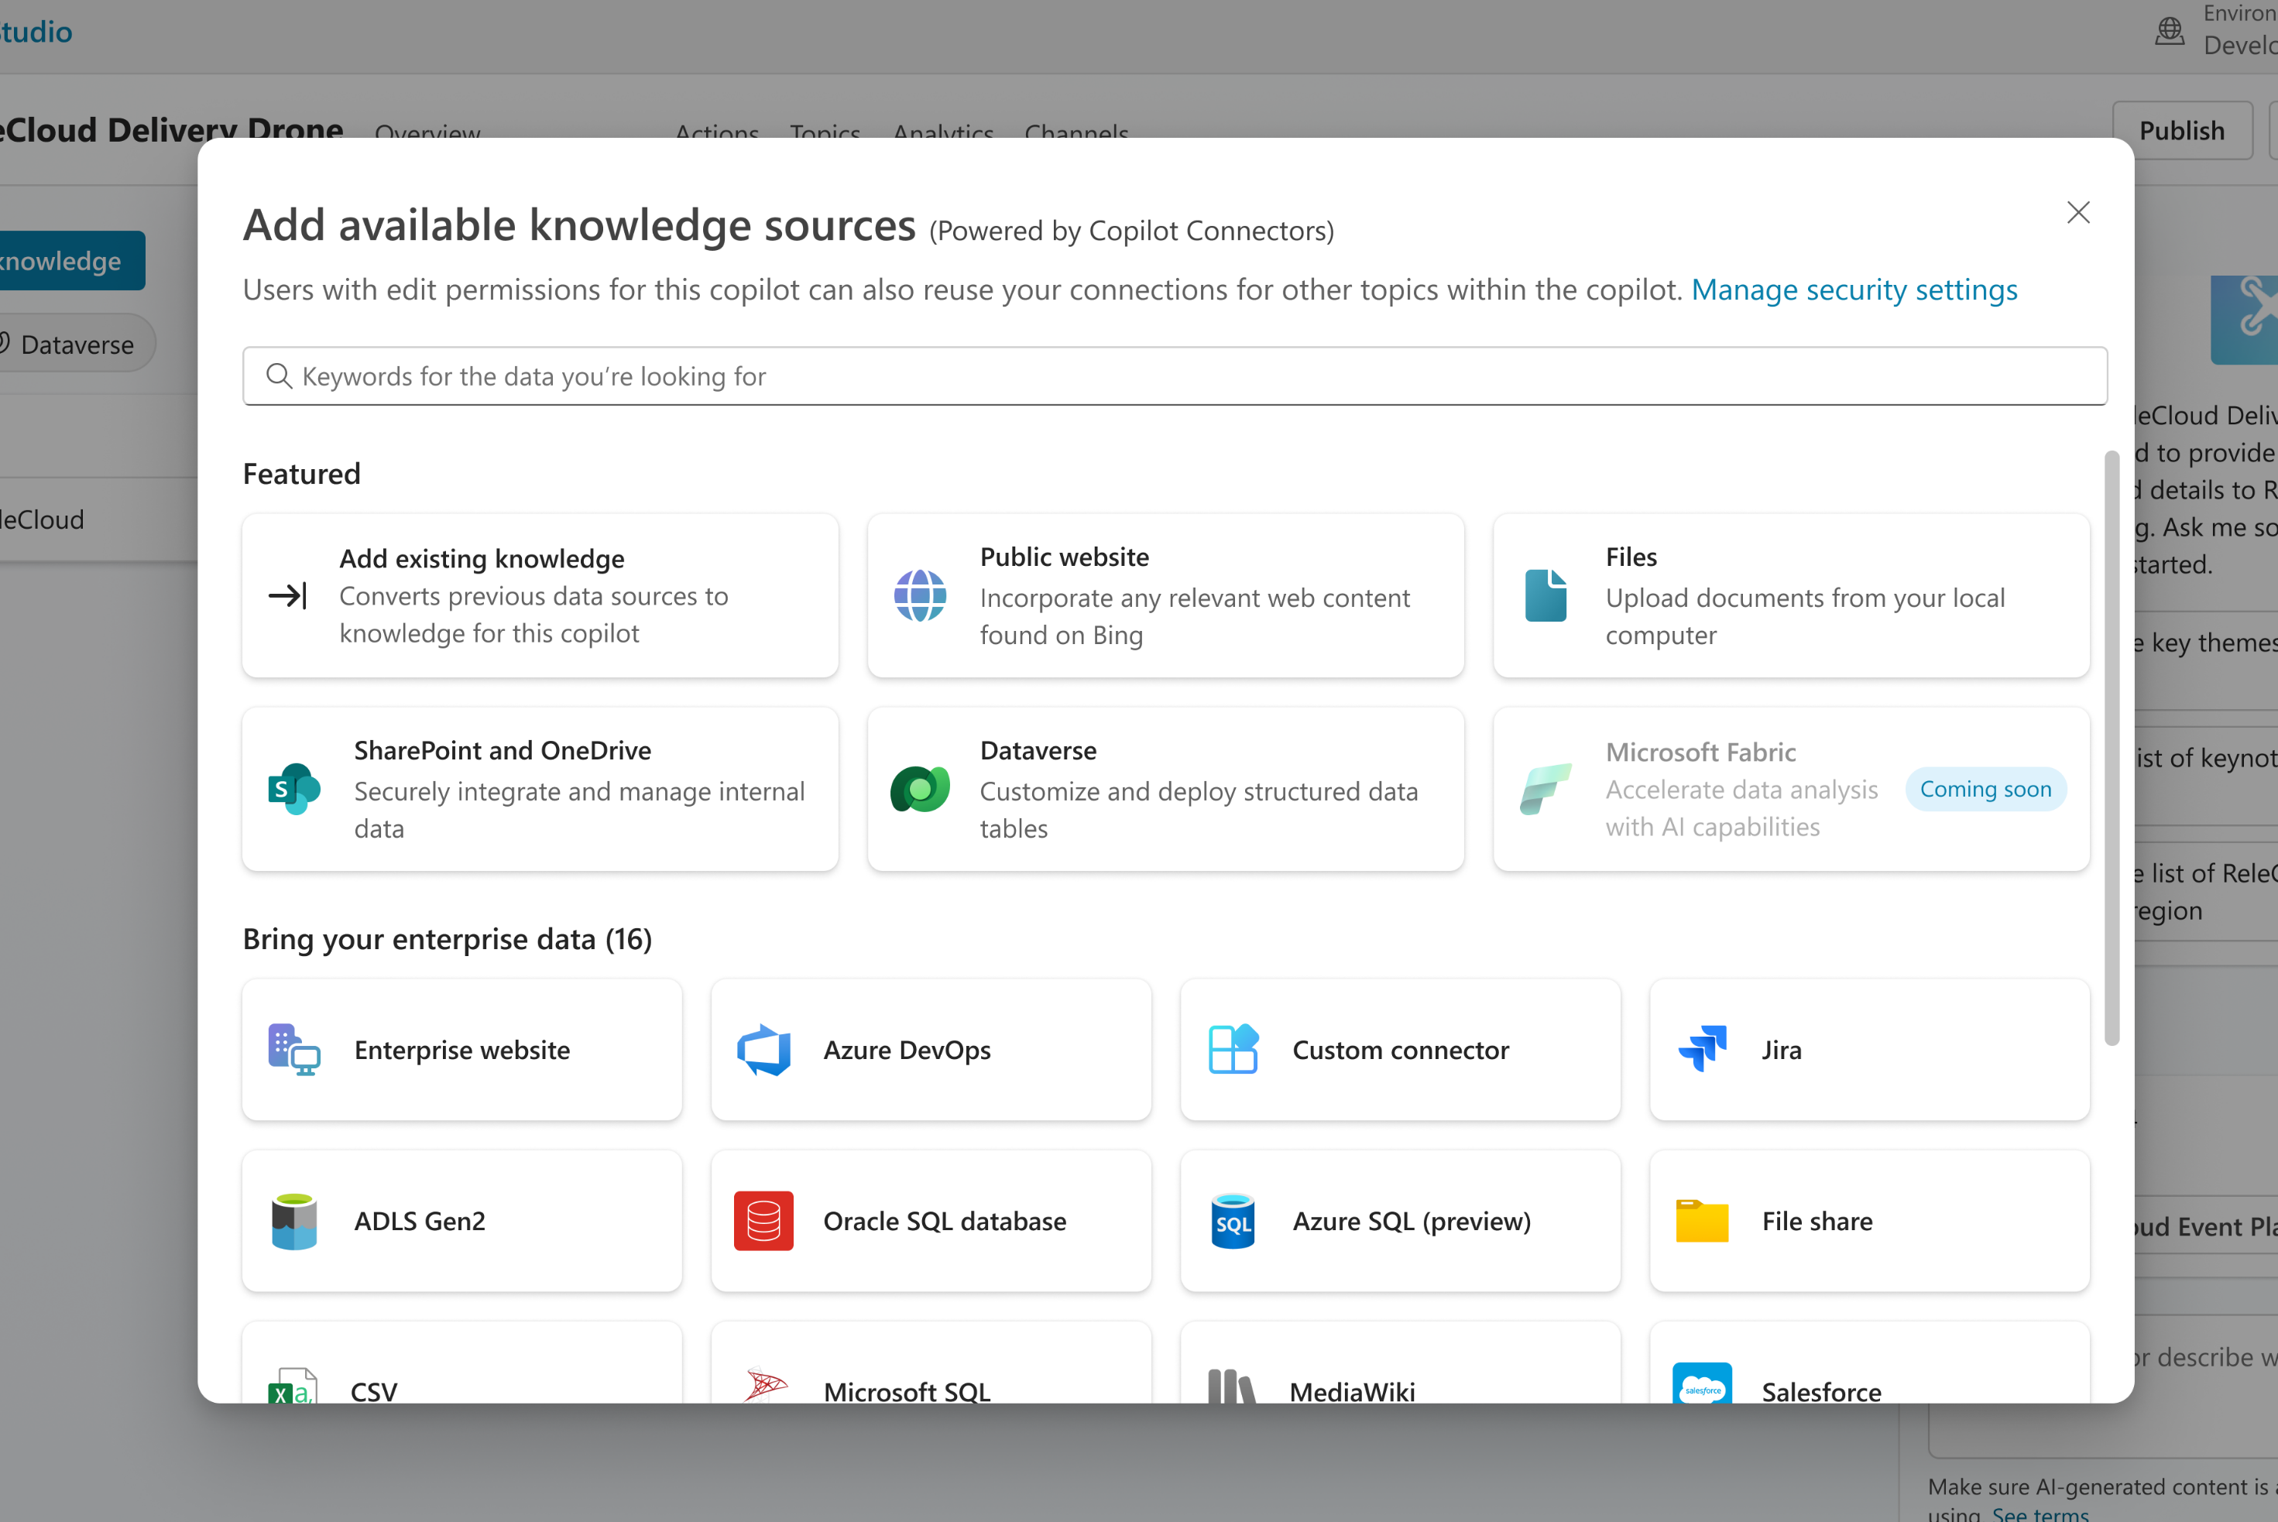
Knowledge / Generative Answers Enable makers to add and manage both public and enterprise data sources. Supported data sources include public websites, SharePoint/OneDrive sites or files, file uploads, Dataverse and other external data sources indexed in Microsoft Graph. New: Azure AI Search * Certain sources are in public preview only
Notes:
Dewain

Slide 6
Announcement slide (dark) with color rotation
Demo
Notes:
Dewain

Slide 7
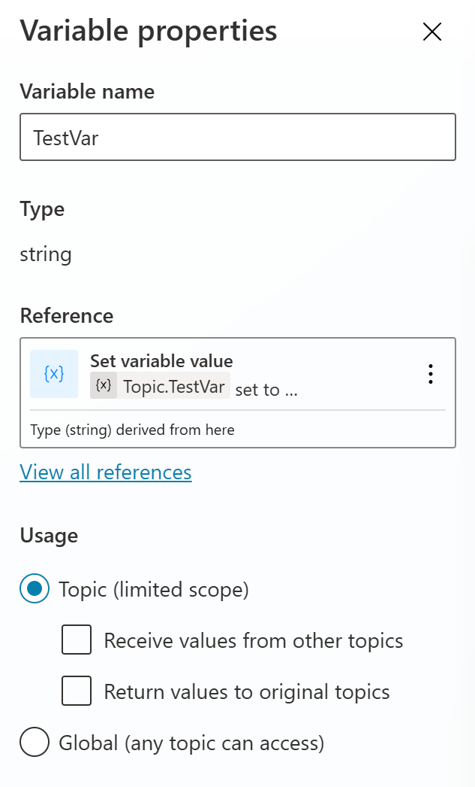
Variables Enable makers to create and use variables - Environment - System - Custom Scopes - Topic - Global - Cross Session
Notes:
Marius

Slide 8
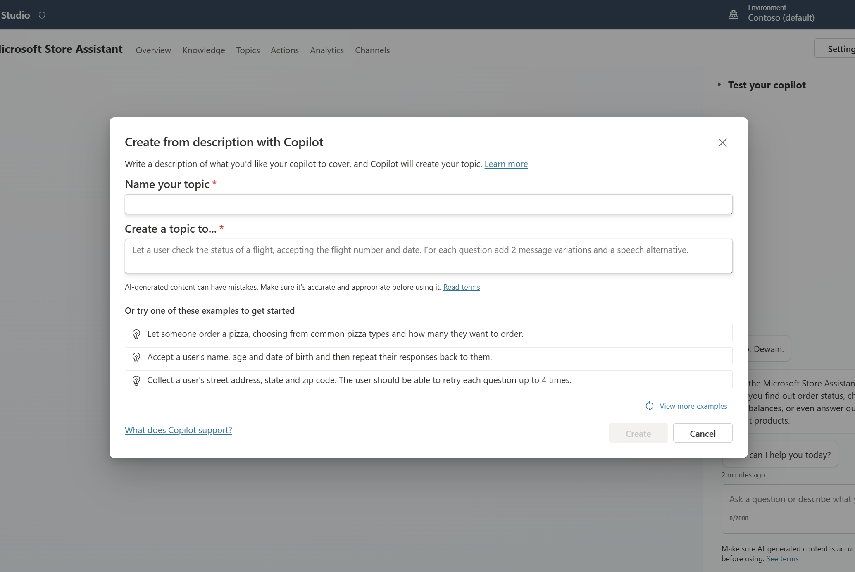
Custom Topics Enable makers to create custom topics - Blank - Create with Copilot - Topics with Inputs
Notes:
Marius

Slide 9
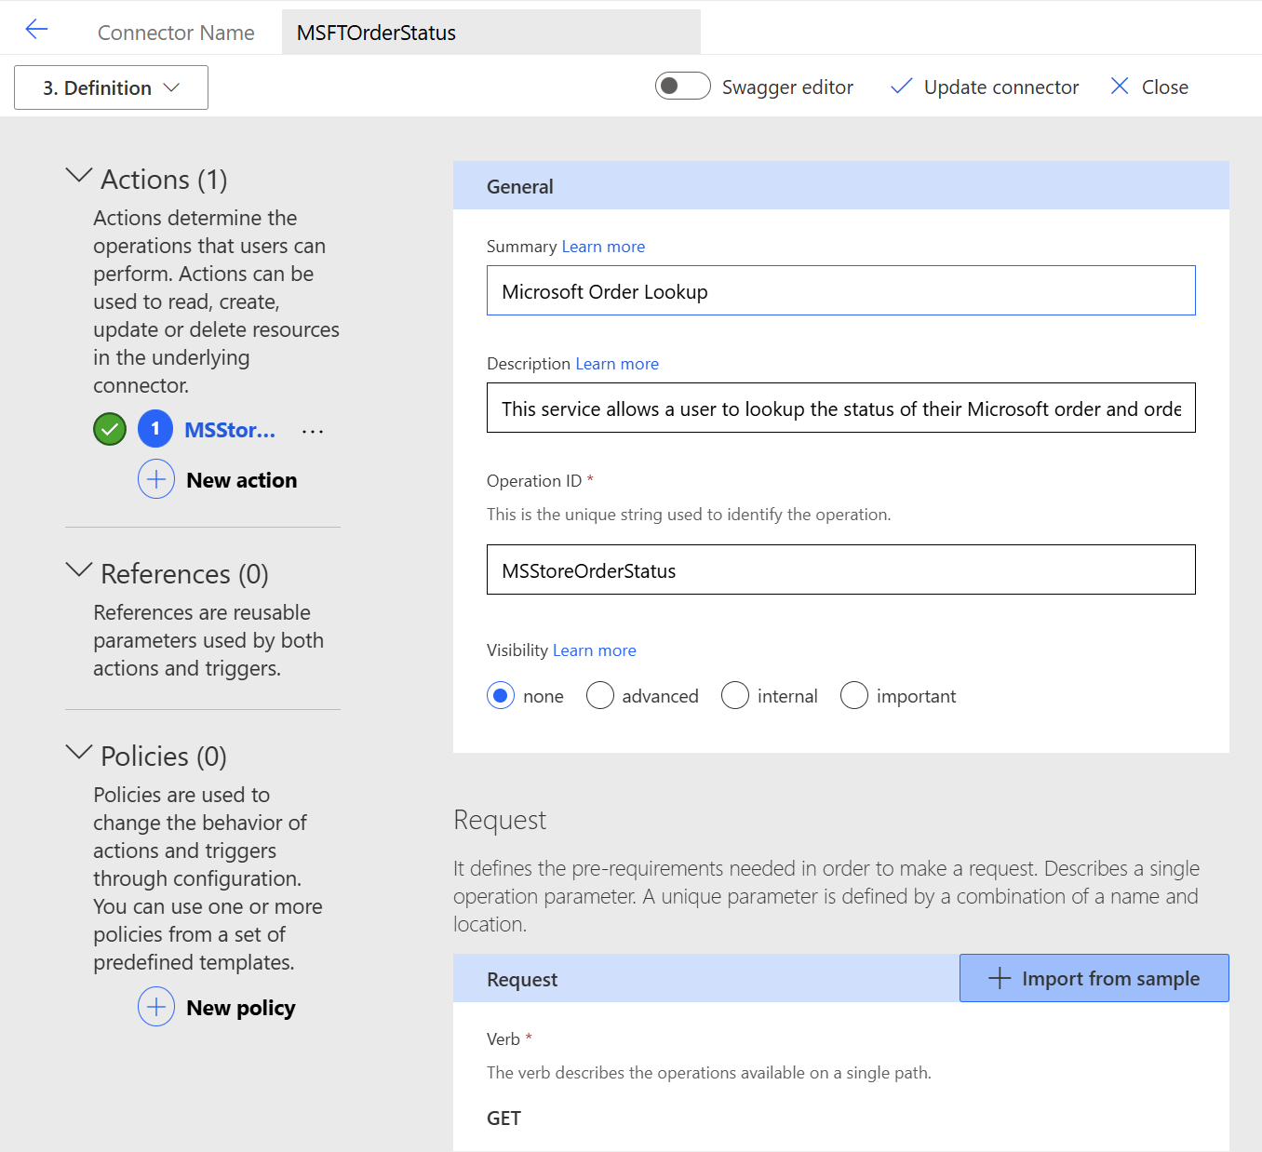
Custom Connectors / Connectors (Power Platform)
Open API / Swagger
Allows for API definition
1,400+ OOB Connectors Today
Easily made into Actions
Can be called directly in Copilot Studio
Notes:
Dewain

Slide 10
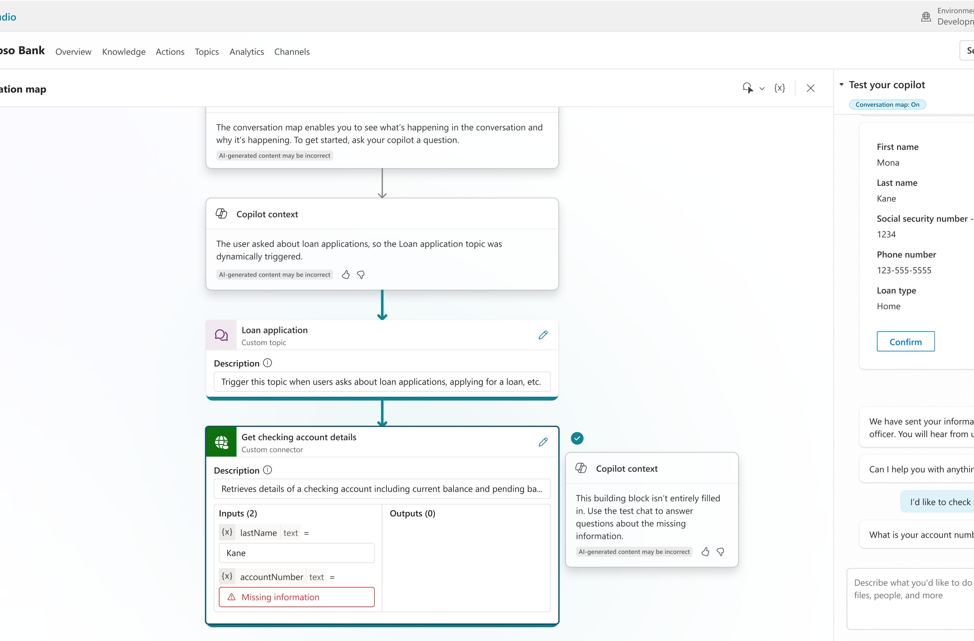
Actions
Conversational Wrapper
Connectors / Flows
Inputs
Outputs
Use in Topics / Top Level intent
Notes:
Dewain

Slide 11
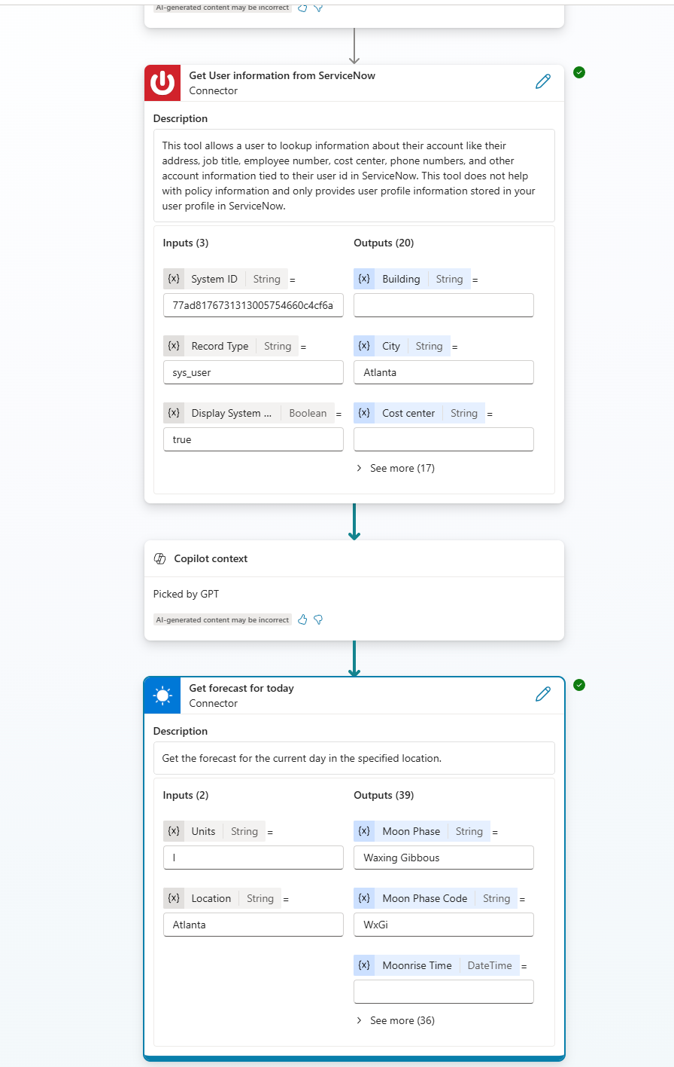
Planner
LLM Intent Routing
LLM Entity Extraction
Dynamic Chaining
Knowledge Routing
Conversation Context Aware
Follow-up Questions
On Plan Complete Trigger
Notes:
Dewain

Slide 12
Announcement slide (dark) with color rotation
Demo
Notes:
Dewain

Slide 13
Do you understand the difference between autonomous agents and Power Automate?
Poll Question:

Slide 14
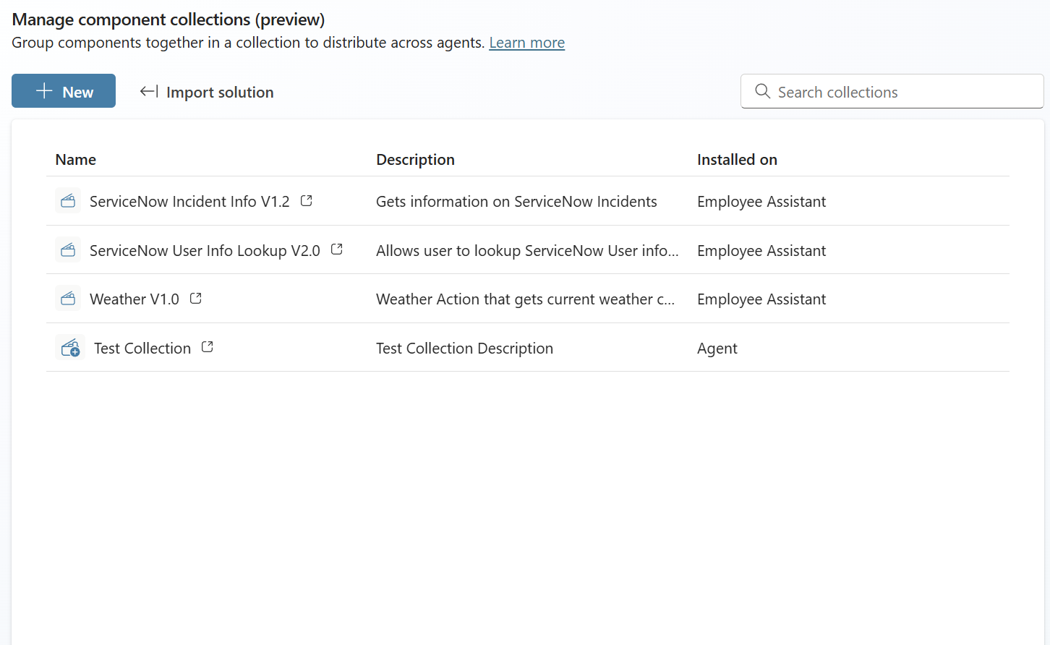
Component Collections
Create once use over and over
Topic / Action / Entity / Knowledge Level Support
Managed / Unmanaged
Solution Aware
Export / Import
Develop Independently
Notes:
Dewain

Slide 15
Announcement slide (dark) with color rotation
Demo
Notes:
Dewain

Slide 16
Thank You

